Slide 1
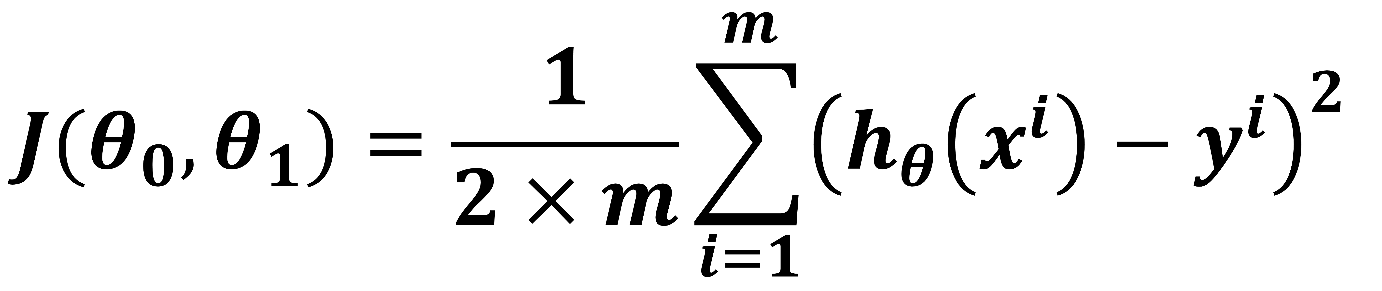
Mean Squared Error Calculation : Example
$$J(θ_{0},θ_{1})=\frac{1}{2×m}\sum_{i=1}^{m}{{\left({h_{θ}\left(x^{i}\right)−y}^{i}\right)}^{2} }$$

Slide 2
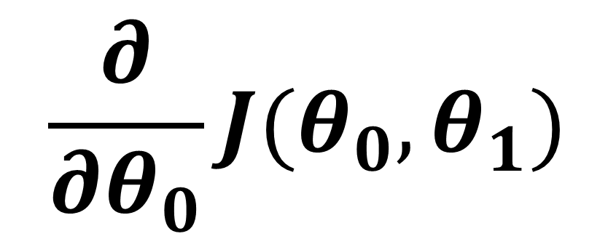
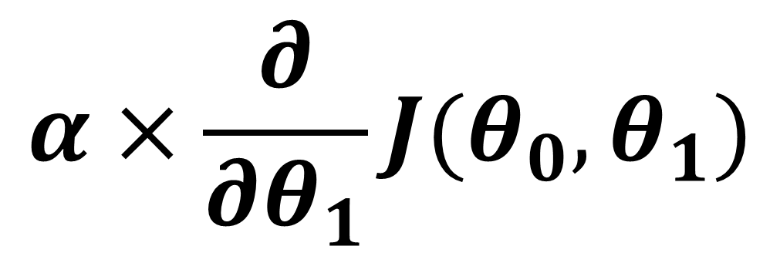
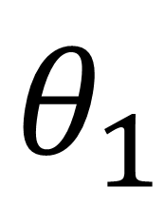
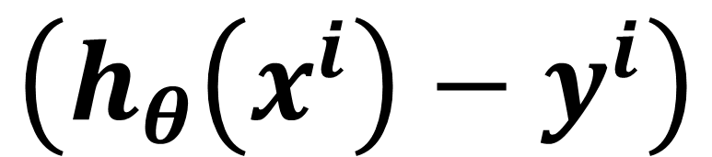
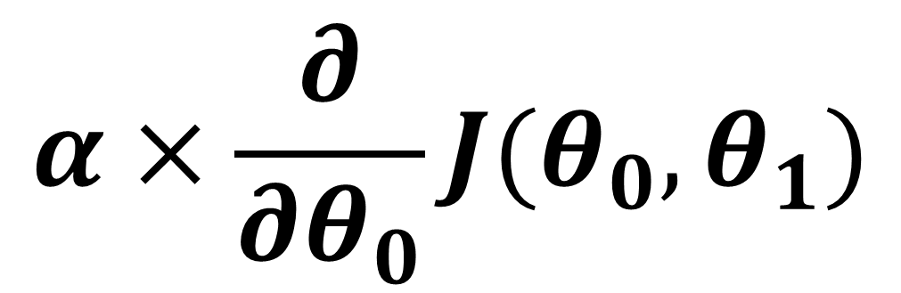
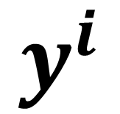
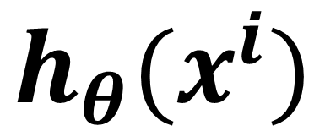
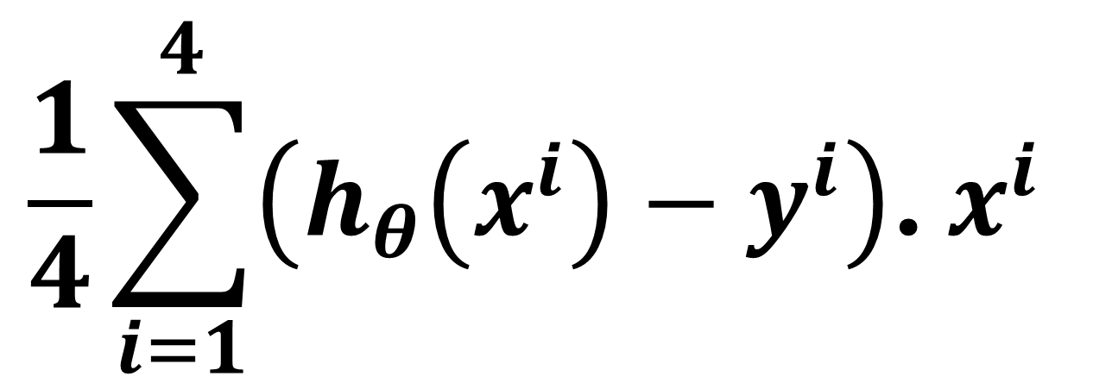
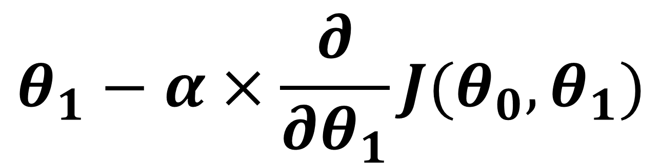
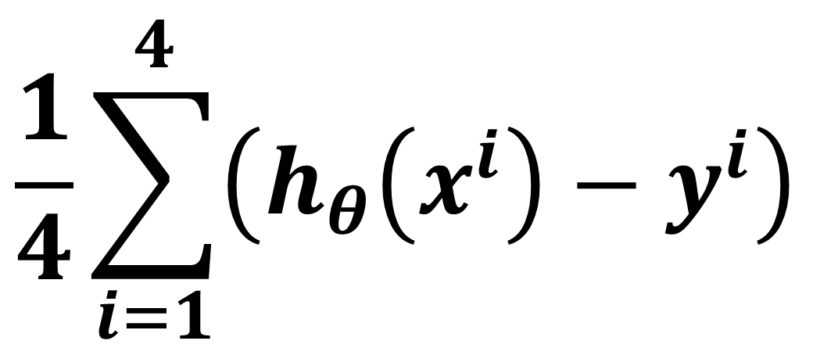
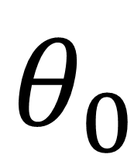
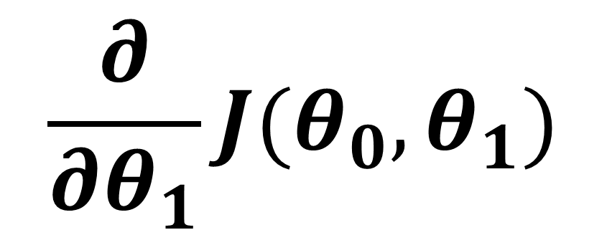
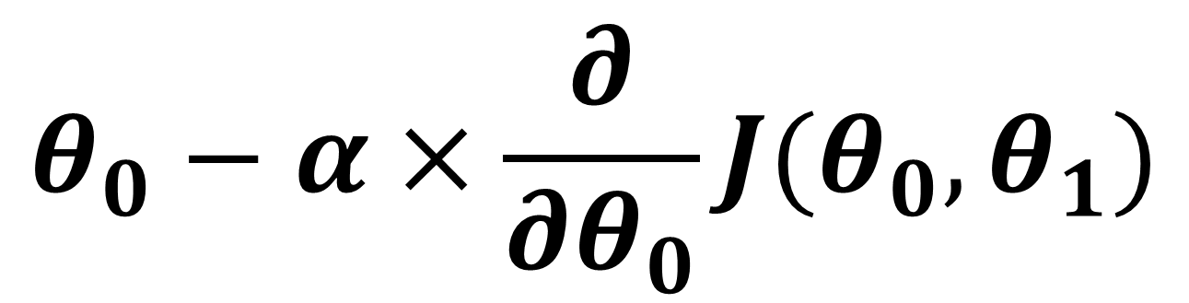
$$θ_{0}$$
$$θ_{1}$$
$$\frac{∂}{∂θ_{0}}J(θ_{0},θ_{1})$$
$$\frac{∂}{∂θ_{1}}J(θ_{0},θ_{1})$$
450 | 0.15
$$\frac{1}{4}\sum_{i=1}^{4}{\left({h_{θ}\left(x^{i}\right)−y}^{i}\right)}$$
$$\frac{1}{4}\sum_{i=1}^{4}{\left({h_{θ}\left(x^{i}\right)−y}^{i}\right)\text{. }x^{i} }$$
$$α×\frac{∂}{∂θ_{0}}J(θ_{0},θ_{1})$$
$$θ_{0}−α×\frac{∂}{∂θ_{0}}J(θ_{0},θ_{1})$$
$$h_{θ}(x^{i})$$
$$y^{i}$$
$$\left({h_{θ}\left(x^{i}\right)−y}^{i}\right)$$
$$y^{i}$$
1 | 2104
1 | 1416
1 | 1534
1 | 852
400
232
315
178
400
232
315
178
$$α×\frac{∂}{∂θ_{1}}J(θ_{0},θ_{1})$$
$$θ_{1}−α×\frac{∂}{∂θ_{1}}J(θ_{0},θ_{1})$$

Slide 3
$$θ_{0}$$
$$θ_{1}$$
$$\frac{∂}{∂θ_{0}}J(θ_{0},θ_{1})$$
$$\frac{∂}{∂θ_{1}}J(θ_{0},θ_{1})$$
450 | 0.15
$$\frac{1}{4}\sum_{i=1}^{4}{\left({h_{θ}\left(x^{i}\right)−y}^{i}\right)}$$
$$\frac{1}{4}\sum_{i=1}^{4}{\left({h_{θ}\left(x^{i}\right)−y}^{i}\right)\text{. }x^{i} }$$
$$α×\frac{∂}{∂θ_{0}}J(θ_{0},θ_{1})$$
$$θ_{0}−α×\frac{∂}{∂θ_{0}}J(θ_{0},θ_{1})$$
$$h_{θ}(x^{i})$$
$$y^{i}$$
$$\left({h_{θ}\left(x^{i}\right)−y}^{i}\right)$$
1 | 2104
1 | 1416
1 | 1534
1 | 852
400
232
315
178
$$α×\frac{∂}{∂θ_{1}}J(θ_{0},θ_{1})$$
$$θ_{1}−α×\frac{∂}{∂θ_{1}}J(θ_{0},θ_{1})$$

Slide 4


$$θ_{0}$$
$$θ_{1}$$
$$\frac{∂}{∂θ_{0}}J(θ_{0},θ_{1})$$
$$\frac{∂}{∂θ_{1}}J(θ_{0},θ_{1})$$
450 | 0.15
$$\frac{1}{4}\sum_{i=1}^{4}{\left({h_{θ}\left(x^{i}\right)−y}^{i}\right)}$$
$$\frac{1}{4}\sum_{i=1}^{4}{\left({h_{θ}\left(x^{i}\right)−y}^{i}\right)\text{. }x^{i} }$$
$$α×\frac{∂}{∂θ_{0}}J(θ_{0},θ_{1})$$
$$θ_{0}−α×\frac{∂}{∂θ_{0}}J(θ_{0},θ_{1})$$
$$×$$
$$×$$
$$h_{θ}(x^{i})$$
$$y^{i}$$
$$\left({h_{θ}\left(x^{i}\right)−y}^{i}\right)$$
1 | 2104
1 | 1416
1 | 1534
1 | 852
400
232
315
178
$$α×\frac{∂}{∂θ_{1}}J(θ_{0},θ_{1})$$
$$θ_{1}−α×\frac{∂}{∂θ_{1}}J(θ_{0},θ_{1})$$

Slide 5
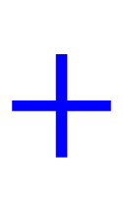
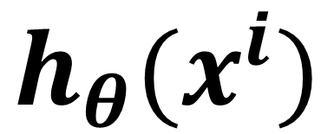
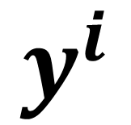
$$θ_{0}$$
$$θ_{1}$$
$$\frac{∂}{∂θ_{0}}J(θ_{0},θ_{1})$$
$$\frac{∂}{∂θ_{1}}J(θ_{0},θ_{1})$$
450 | 0.15
$$\frac{1}{4}\sum_{i=1}^{4}{\left({h_{θ}\left(x^{i}\right)−y}^{i}\right)}$$
$$\frac{1}{4}\sum_{i=1}^{4}{\left({h_{θ}\left(x^{i}\right)−y}^{i}\right)\text{. }x^{i} }$$
$$α×\frac{∂}{∂θ_{0}}J(θ_{0},θ_{1})$$
$$θ_{0}−α×\frac{∂}{∂θ_{0}}J(θ_{0},θ_{1})$$
$$×$$
$$×$$
$$h_{θ}(x^{i})$$
$$y^{i}$$
$$\left({h_{θ}\left(x^{i}\right)−y}^{i}\right)$$
1 | 2104
1 | 1416
1 | 1534
1 | 852
$$+$$
450+315.6
400
232
315
178
$$α×\frac{∂}{∂θ_{1}}J(θ_{0},θ_{1})$$
$$θ_{1}−α×\frac{∂}{∂θ_{1}}J(θ_{0},θ_{1})$$

Slide 6
$$θ_{0}$$
$$θ_{1}$$
$$\frac{∂}{∂θ_{0}}J(θ_{0},θ_{1})$$
$$\frac{∂}{∂θ_{1}}J(θ_{0},θ_{1})$$
450 | 0.15
$$\frac{1}{4}\sum_{i=1}^{4}{\left({h_{θ}\left(x^{i}\right)−y}^{i}\right)}$$
$$\frac{1}{4}\sum_{i=1}^{4}{\left({h_{θ}\left(x^{i}\right)−y}^{i}\right)\text{. }x^{i} }$$
$$α×\frac{∂}{∂θ_{0}}J(θ_{0},θ_{1})$$
$$θ_{0}−α×\frac{∂}{∂θ_{0}}J(θ_{0},θ_{1})$$
$$×$$
$$×$$
$$h_{θ}(x^{i})$$
$$y^{i}$$
$$\left({h_{θ}\left(x^{i}\right)−y}^{i}\right)$$
1 | 2104
1 | 1416
1 | 1534
1 | 852
$$+$$
765.6
400
232
315
178
$$α×\frac{∂}{∂θ_{1}}J(θ_{0},θ_{1})$$
$$θ_{1}−α×\frac{∂}{∂θ_{1}}J(θ_{0},θ_{1})$$

Slide 7
$$θ_{0}$$
$$θ_{1}$$
$$\frac{∂}{∂θ_{0}}J(θ_{0},θ_{1})$$
$$\frac{∂}{∂θ_{1}}J(θ_{0},θ_{1})$$
450 | 0.15
$$\frac{1}{4}\sum_{i=1}^{4}{\left({h_{θ}\left(x^{i}\right)−y}^{i}\right)}$$
$$\frac{1}{4}\sum_{i=1}^{4}{\left({h_{θ}\left(x^{i}\right)−y}^{i}\right)\text{. }x^{i} }$$
$$α×\frac{∂}{∂θ_{0}}J(θ_{0},θ_{1})$$
$$θ_{0}−α×\frac{∂}{∂θ_{0}}J(θ_{0},θ_{1})$$
$$×$$
$$×$$
$$h_{θ}(x^{i})$$
$$y^{i}$$
$$\left({h_{θ}\left(x^{i}\right)−y}^{i}\right)$$
1 | 2104
1 | 1416
1 | 1534
1 | 852
765.6
400
232
315
178
$$α×\frac{∂}{∂θ_{1}}J(θ_{0},θ_{1})$$
$$θ_{1}−α×\frac{∂}{∂θ_{1}}J(θ_{0},θ_{1})$$

Slide 8

$$θ_{0}$$
$$θ_{1}$$
$$\frac{∂}{∂θ_{0}}J(θ_{0},θ_{1})$$
$$\frac{∂}{∂θ_{1}}J(θ_{0},θ_{1})$$
450 | 0.15
$$\frac{1}{4}\sum_{i=1}^{4}{\left({h_{θ}\left(x^{i}\right)−y}^{i}\right)}$$
$$\frac{1}{4}\sum_{i=1}^{4}{\left({h_{θ}\left(x^{i}\right)−y}^{i}\right)\text{. }x^{i} }$$
$$α×\frac{∂}{∂θ_{0}}J(θ_{0},θ_{1})$$
$$θ_{0}−α×\frac{∂}{∂θ_{0}}J(θ_{0},θ_{1})$$
$$×$$
$$×$$
$$h_{θ}(x^{i})$$
$$y^{i}$$
$$\left({h_{θ}\left(x^{i}\right)−y}^{i}\right)$$
1 | 2104
1 | 1416
1 | 1534
1 | 852
765.6
662.4
400
232
315
178
$$α×\frac{∂}{∂θ_{1}}J(θ_{0},θ_{1})$$
$$θ_{1}−α×\frac{∂}{∂θ_{1}}J(θ_{0},θ_{1})$$
$$+$$

Slide 9
$$θ_{0}$$
$$θ_{1}$$
$$\frac{∂}{∂θ_{0}}J(θ_{0},θ_{1})$$
$$\frac{∂}{∂θ_{1}}J(θ_{0},θ_{1})$$
450 | 0.15
$$\frac{1}{4}\sum_{i=1}^{4}{\left({h_{θ}\left(x^{i}\right)−y}^{i}\right)}$$
$$\frac{1}{4}\sum_{i=1}^{4}{\left({h_{θ}\left(x^{i}\right)−y}^{i}\right)\text{. }x^{i} }$$
$$α×\frac{∂}{∂θ_{0}}J(θ_{0},θ_{1})$$
$$θ_{0}−α×\frac{∂}{∂θ_{0}}J(θ_{0},θ_{1})$$
$$×$$
$$×$$
$$h_{θ}(x^{i})$$
$$y^{i}$$
$$\left({h_{θ}\left(x^{i}\right)−y}^{i}\right)$$
1 | 2104
1 | 1416
1 | 1534
1 | 852
765.6
662.4
400
232
315
178
$$α×\frac{∂}{∂θ_{1}}J(θ_{0},θ_{1})$$
$$θ_{1}−α×\frac{∂}{∂θ_{1}}J(θ_{0},θ_{1})$$

Slide 10

$$θ_{0}$$
$$θ_{1}$$
$$\frac{∂}{∂θ_{0}}J(θ_{0},θ_{1})$$
$$\frac{∂}{∂θ_{1}}J(θ_{0},θ_{1})$$
450 | 0.15
$$\frac{1}{4}\sum_{i=1}^{4}{\left({h_{θ}\left(x^{i}\right)−y}^{i}\right)}$$
$$\frac{1}{4}\sum_{i=1}^{4}{\left({h_{θ}\left(x^{i}\right)−y}^{i}\right)\text{. }x^{i} }$$
$$α×\frac{∂}{∂θ_{0}}J(θ_{0},θ_{1})$$
$$θ_{0}−α×\frac{∂}{∂θ_{0}}J(θ_{0},θ_{1})$$
$$×$$
$$×$$
$$h_{θ}(x^{i})$$
$$y^{i}$$
$$\left({h_{θ}\left(x^{i}\right)−y}^{i}\right)$$
1 | 2104
1 | 1416
1 | 1534
1 | 852
765.6
662.4
680.1
400
232
315
178
$$α×\frac{∂}{∂θ_{1}}J(θ_{0},θ_{1})$$
$$θ_{1}−α×\frac{∂}{∂θ_{1}}J(θ_{0},θ_{1})$$
$$+$$

Slide 11
$$θ_{0}$$
$$θ_{1}$$
$$\frac{∂}{∂θ_{0}}J(θ_{0},θ_{1})$$
$$\frac{∂}{∂θ_{1}}J(θ_{0},θ_{1})$$
450 | 0.15
$$\frac{1}{4}\sum_{i=1}^{4}{\left({h_{θ}\left(x^{i}\right)−y}^{i}\right)}$$
$$\frac{1}{4}\sum_{i=1}^{4}{\left({h_{θ}\left(x^{i}\right)−y}^{i}\right)\text{. }x^{i} }$$
$$α×\frac{∂}{∂θ_{0}}J(θ_{0},θ_{1})$$
$$θ_{0}−α×\frac{∂}{∂θ_{0}}J(θ_{0},θ_{1})$$
$$×$$
$$×$$
$$h_{θ}(x^{i})$$
$$y^{i}$$
$$\left({h_{θ}\left(x^{i}\right)−y}^{i}\right)$$
1 | 2104
1 | 1416
1 | 1534
1 | 852
765.6
662.4
680.1
400
232
315
178
$$α×\frac{∂}{∂θ_{1}}J(θ_{0},θ_{1})$$
$$θ_{1}−α×\frac{∂}{∂θ_{1}}J(θ_{0},θ_{1})$$

Slide 12

$$θ_{0}$$
$$θ_{1}$$
$$\frac{∂}{∂θ_{0}}J(θ_{0},θ_{1})$$
$$\frac{∂}{∂θ_{1}}J(θ_{0},θ_{1})$$
450 | 0.15
$$\frac{1}{4}\sum_{i=1}^{4}{\left({h_{θ}\left(x^{i}\right)−y}^{i}\right)}$$
$$\frac{1}{4}\sum_{i=1}^{4}{\left({h_{θ}\left(x^{i}\right)−y}^{i}\right)\text{. }x^{i} }$$
$$α×\frac{∂}{∂θ_{0}}J(θ_{0},θ_{1})$$
$$θ_{0}−α×\frac{∂}{∂θ_{0}}J(θ_{0},θ_{1})$$
$$×$$
$$×$$
$$h_{θ}(x^{i})$$
$$y^{i}$$
$$\left({h_{θ}\left(x^{i}\right)−y}^{i}\right)$$
1 | 2104
1 | 1416
1 | 1534
1 | 852
765.6
662.4
680.1
577.8
400
232
315
178
$$α×\frac{∂}{∂θ_{1}}J(θ_{0},θ_{1})$$
$$θ_{1}−α×\frac{∂}{∂θ_{1}}J(θ_{0},θ_{1})$$
$$+$$

Slide 13
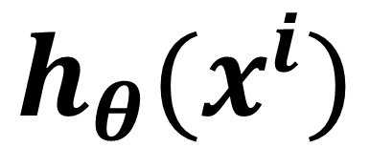
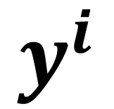
$$θ_{0}$$
$$θ_{1}$$
$$\frac{∂}{∂θ_{0}}J(θ_{0},θ_{1})$$
$$\frac{∂}{∂θ_{1}}J(θ_{0},θ_{1})$$
450 | 0.15
$$\frac{1}{4}\sum_{i=1}^{4}{\left({h_{θ}\left(x^{i}\right)−y}^{i}\right)}$$
$$\frac{1}{4}\sum_{i=1}^{4}{\left({h_{θ}\left(x^{i}\right)−y}^{i}\right)\text{. }x^{i} }$$
$$α×\frac{∂}{∂θ_{0}}J(θ_{0},θ_{1})$$
$$θ_{0}−α×\frac{∂}{∂θ_{0}}J(θ_{0},θ_{1})$$
$$h_{θ}(x^{i})$$
$$y^{i}$$
$$\left({h_{θ}\left(x^{i}\right)−y}^{i}\right)$$
1 | 2104
1 | 1416
1 | 1534
1 | 852
765.6
662.4
680.1
577.8
400
232
315
178
$$α×\frac{∂}{∂θ_{1}}J(θ_{0},θ_{1})$$
$$θ_{1}−α×\frac{∂}{∂θ_{1}}J(θ_{0},θ_{1})$$

Slide 14



$$θ_{0}$$
$$θ_{1}$$
$$\frac{∂}{∂θ_{0}}J(θ_{0},θ_{1})$$
$$\frac{∂}{∂θ_{1}}J(θ_{0},θ_{1})$$
450 | 0.15
$$\frac{1}{4}\sum_{i=1}^{4}{\left({h_{θ}\left(x^{i}\right)−y}^{i}\right)}$$
$$\frac{1}{4}\sum_{i=1}^{4}{\left({h_{θ}\left(x^{i}\right)−y}^{i}\right)\text{. }x^{i} }$$
$$α×\frac{∂}{∂θ_{0}}J(θ_{0},θ_{1})$$
$$θ_{0}−α×\frac{∂}{∂θ_{0}}J(θ_{0},θ_{1})$$
$$h_{θ}(x^{i})$$
$$y^{i}$$
$$\left({h_{θ}\left(x^{i}\right)−y}^{i}\right)$$
1 | 2104
1 | 1416
1 | 1534
1 | 852
765.6
662.4
680.1
577.8
400
232
315
178
$$−$$
365.6
430.4
365.1
399.8
$$α×\frac{∂}{∂θ_{1}}J(θ_{0},θ_{1})$$
$$θ_{1}−α×\frac{∂}{∂θ_{1}}J(θ_{0},θ_{1})$$
$$−$$
$$−$$
$$−$$

Slide 15
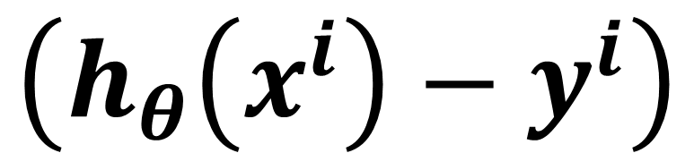
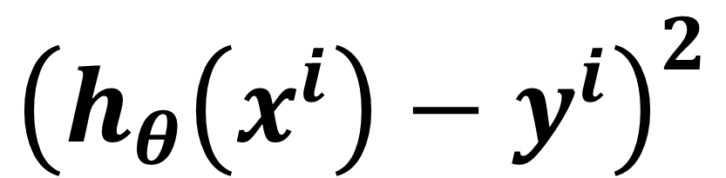
$$θ_{0}$$
$$θ_{1}$$
$$\frac{∂}{∂θ_{0}}J(θ_{0},θ_{1})$$
$$\frac{∂}{∂θ_{1}}J(θ_{0},θ_{1})$$
450 | 0.15
$$\frac{1}{4}\sum_{i=1}^{4}{\left({h_{θ}\left(x^{i}\right)−y}^{i}\right)}$$
$$\frac{1}{4}\sum_{i=1}^{4}{\left({h_{θ}\left(x^{i}\right)−y}^{i}\right)\text{. }x^{i} }$$
$$α×\frac{∂}{∂θ_{0}}J(θ_{0},θ_{1})$$
$$θ_{0}−α×\frac{∂}{∂θ_{0}}J(θ_{0},θ_{1})$$
$$h_{θ}(x^{i})$$
$$y^{i}$$
$$\left({h_{θ}\left(x^{i}\right)−y}^{i}\right)$$
$${\left({h_{θ}\left(x^{i}\right)−y}^{i}\right)}^{2}$$
1 | 2104
1 | 1416
1 | 1534
1 | 852
765.6
662.4
680.1
577.8
400
232
315
178
365.6
430.4
365.1
399.8
133,663
184,900
133,225
159,840
$$α×\frac{∂}{∂θ_{1}}J(θ_{0},θ_{1})$$
Squared
$$θ_{1}−α×\frac{∂}{∂θ_{1}}J(θ_{0},θ_{1})$$
Squared
Squared
Squared

Slide 16
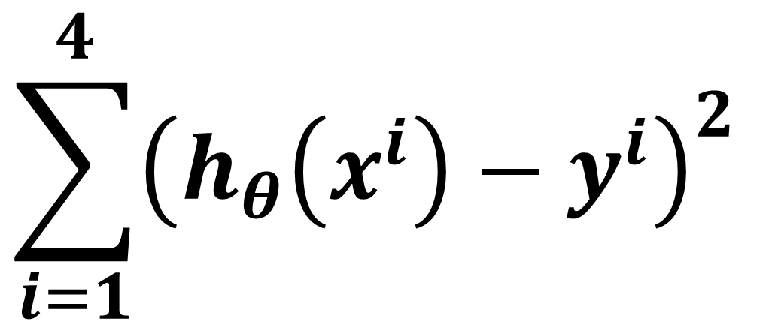
$$θ_{0}$$
$$θ_{1}$$
$$\frac{∂}{∂θ_{0}}J(θ_{0},θ_{1})$$
$$\frac{∂}{∂θ_{1}}J(θ_{0},θ_{1})$$
450 | 0.15
$$\frac{1}{4}\sum_{i=1}^{4}{\left({h_{θ}\left(x^{i}\right)−y}^{i}\right)}$$
$$\frac{1}{4}\sum_{i=1}^{4}{\left({h_{θ}\left(x^{i}\right)−y}^{i}\right)\text{. }x^{i} }$$
$$\sum_{i=1}^{4}{{\left({h_{θ}\left(x^{i}\right)−y}^{i}\right)}^{2} }$$
$$θ_{0}−α×\frac{∂}{∂θ_{0}}J(θ_{0},θ_{1})$$
$${\left({h_{θ}\left(x^{i}\right)−y}^{i}\right)}^{2}$$
$$α×\frac{∂}{∂θ_{0}}J(θ_{0},θ_{1})$$
$$h_{θ}(x^{i})$$
$$y^{i}$$
$$\left({h_{θ}\left(x^{i}\right)−y}^{i}\right)$$
1 | 2104
1 | 1416
1 | 1534
1 | 852
765.6
662.4
680.1
577.8
400
232
315
178
365.6
430.4
365.1
399.8
133,663
184,900
133,225
159,840
$$α×\frac{∂}{∂θ_{1}}J(θ_{0},θ_{1})$$
$$θ_{1}−α×\frac{∂}{∂θ_{1}}J(θ_{0},θ_{1})$$
sum
611,628
sum
sum
sum

Slide 17
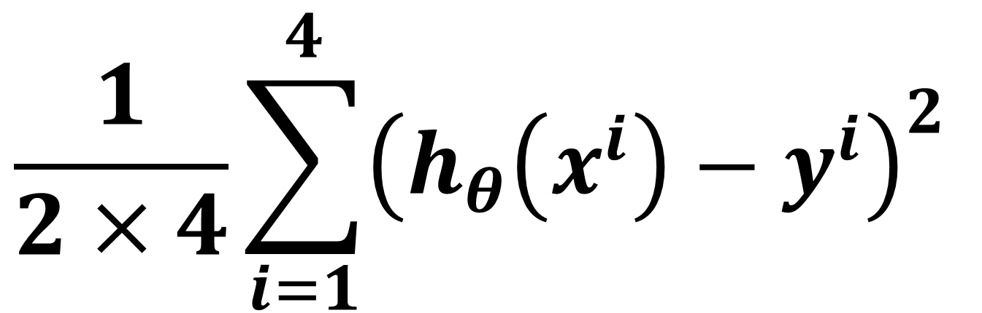
$$θ_{0}$$
$$θ_{1}$$
$$\frac{∂}{∂θ_{0}}J(θ_{0},θ_{1})$$
$$\frac{∂}{∂θ_{1}}J(θ_{0},θ_{1})$$
450 | 0.15
$$\frac{1}{4}\sum_{i=1}^{4}{\left({h_{θ}\left(x^{i}\right)−y}^{i}\right)}$$
$$\frac{1}{4}\sum_{i=1}^{4}{\left({h_{θ}\left(x^{i}\right)−y}^{i}\right)\text{. }x^{i} }$$
$$\frac{1}{2×4}\sum_{i=1}^{4}{{\left({h_{θ}\left(x^{i}\right)−y}^{i}\right)}^{2} }$$
$$\sum_{i=1}^{4}{{\left({h_{θ}\left(x^{i}\right)−y}^{i}\right)}^{2} }$$
$$θ_{0}−α×\frac{∂}{∂θ_{0}}J(θ_{0},θ_{1})$$
$${\left({h_{θ}\left(x^{i}\right)−y}^{i}\right)}^{2}$$
$$α×\frac{∂}{∂θ_{0}}J(θ_{0},θ_{1})$$
$$h_{θ}(x^{i})$$
$$y^{i}$$
$$\left({h_{θ}\left(x^{i}\right)−y}^{i}\right)$$
1 | 2104
1 | 1416
1 | 1534
1 | 852
765.6
662.4
680.1
577.8
400
232
315
178
365.6
430.4
365.1
399.8
133,663
184,900
133,225
159,840
$$α×\frac{∂}{∂θ_{1}}J(θ_{0},θ_{1})$$
$$θ_{1}−α×\frac{∂}{∂θ_{1}}J(θ_{0},θ_{1})$$
611,628
74,453
divide by 2m

Slide 18
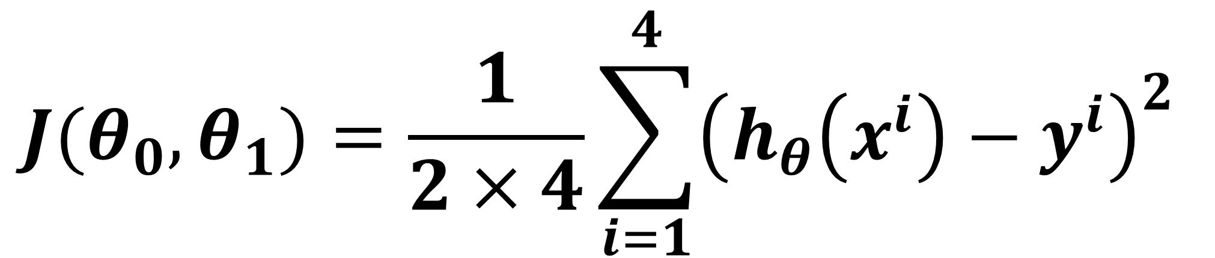
$$θ_{0}$$
$$θ_{1}$$
$$\frac{∂}{∂θ_{0}}J(θ_{0},θ_{1})$$
$$\frac{∂}{∂θ_{1}}J(θ_{0},θ_{1})$$
450 | 0.15
Cost at iteration 0 using values of THETA_0 and THETA_1
$$\frac{1}{4}\sum_{i=1}^{4}{\left({h_{θ}\left(x^{i}\right)−y}^{i}\right)}$$
$$\frac{1}{4}\sum_{i=1}^{4}{\left({h_{θ}\left(x^{i}\right)−y}^{i}\right)\text{. }x^{i} }$$
$$J(θ_{0},θ_{1})=\frac{1}{2×4}\sum_{i=1}^{4}{{\left({h_{θ}\left(x^{i}\right)−y}^{i}\right)}^{2} }$$
$$\sum_{i=1}^{4}{{\left({h_{θ}\left(x^{i}\right)−y}^{i}\right)}^{2} }$$
$$θ_{0}−α×\frac{∂}{∂θ_{0}}J(θ_{0},θ_{1})$$
$${\left({h_{θ}\left(x^{i}\right)−y}^{i}\right)}^{2}$$
$$α×\frac{∂}{∂θ_{0}}J(θ_{0},θ_{1})$$
$$h_{θ}(x^{i})$$
$$y^{i}$$
$$\left({h_{θ}\left(x^{i}\right)−y}^{i}\right)$$
1 | 2104
1 | 1416
1 | 1534
1 | 852
765.6
662.4
680.1
577.8
400
232
315
178
365.6
430.4
365.1
399.8
133,663
184,900
133,225
159,840
$$α×\frac{∂}{∂θ_{1}}J(θ_{0},θ_{1})$$
$$θ_{1}−α×\frac{∂}{∂θ_{1}}J(θ_{0},θ_{1})$$
611,628
74,453

Slide 19
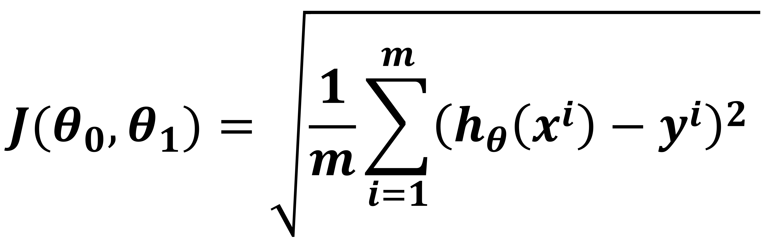
Root Mean Squared Error Calculation (RMSE)
$$J(θ_{0},θ_{1})=\sqrt{\frac{1}{m}\sum_{i=1}^{m}{{\left({h_{θ}\left(x^{i}\right)−y}^{i}\right)}^{2} }}$$

Slide 20
$$θ_{0}$$
$$θ_{1}$$
$$\frac{∂}{∂θ_{0}}J(θ_{0},θ_{1})$$
$$\frac{∂}{∂θ_{1}}J(θ_{0},θ_{1})$$
450 | 0.15
$$\frac{1}{4}\sum_{i=1}^{4}{\left({h_{θ}\left(x^{i}\right)−y}^{i}\right)}$$
$$\frac{1}{4}\sum_{i=1}^{4}{\left({h_{θ}\left(x^{i}\right)−y}^{i}\right)\text{. }x^{i} }$$
$$α×\frac{∂}{∂θ_{0}}J(θ_{0},θ_{1})$$
$$θ_{0}−α×\frac{∂}{∂θ_{0}}J(θ_{0},θ_{1})$$
$$h_{θ}(x^{i})$$
$$y^{i}$$
$$\left({h_{θ}\left(x^{i}\right)−y}^{i}\right)$$
$$y^{i}$$
1 | 2104
1 | 1416
1 | 1534
1 | 852
400
232
315
178
400
232
315
178
$$α×\frac{∂}{∂θ_{1}}J(θ_{0},θ_{1})$$
$$θ_{1}−α×\frac{∂}{∂θ_{1}}J(θ_{0},θ_{1})$$

Slide 21
$$θ_{0}$$
$$θ_{1}$$
$$\frac{∂}{∂θ_{0}}J(θ_{0},θ_{1})$$
$$\frac{∂}{∂θ_{1}}J(θ_{0},θ_{1})$$
450 | 0.15
$$\frac{1}{4}\sum_{i=1}^{4}{\left({h_{θ}\left(x^{i}\right)−y}^{i}\right)}$$
$$\frac{1}{4}\sum_{i=1}^{4}{\left({h_{θ}\left(x^{i}\right)−y}^{i}\right)\text{. }x^{i} }$$
$$α×\frac{∂}{∂θ_{0}}J(θ_{0},θ_{1})$$
$$θ_{0}−α×\frac{∂}{∂θ_{0}}J(θ_{0},θ_{1})$$
$$h_{θ}(x^{i})$$
$$y^{i}$$
$$\left({h_{θ}\left(x^{i}\right)−y}^{i}\right)$$
1 | 2104
1 | 1416
1 | 1534
1 | 852
400
232
315
178
$$α×\frac{∂}{∂θ_{1}}J(θ_{0},θ_{1})$$
$$θ_{1}−α×\frac{∂}{∂θ_{1}}J(θ_{0},θ_{1})$$

Slide 22
$$θ_{0}$$
$$θ_{1}$$
$$\frac{∂}{∂θ_{0}}J(θ_{0},θ_{1})$$
$$\frac{∂}{∂θ_{1}}J(θ_{0},θ_{1})$$
450 | 0.15
$$\frac{1}{4}\sum_{i=1}^{4}{\left({h_{θ}\left(x^{i}\right)−y}^{i}\right)}$$
$$\frac{1}{4}\sum_{i=1}^{4}{\left({h_{θ}\left(x^{i}\right)−y}^{i}\right)\text{. }x^{i} }$$
$$α×\frac{∂}{∂θ_{0}}J(θ_{0},θ_{1})$$
$$θ_{0}−α×\frac{∂}{∂θ_{0}}J(θ_{0},θ_{1})$$
$$×$$
$$×$$
$$h_{θ}(x^{i})$$
$$y^{i}$$
$$\left({h_{θ}\left(x^{i}\right)−y}^{i}\right)$$
1 | 2104
1 | 1416
1 | 1534
1 | 852
400
232
315
178
$$α×\frac{∂}{∂θ_{1}}J(θ_{0},θ_{1})$$
$$θ_{1}−α×\frac{∂}{∂θ_{1}}J(θ_{0},θ_{1})$$

Slide 23
$$θ_{0}$$
$$θ_{1}$$
$$\frac{∂}{∂θ_{0}}J(θ_{0},θ_{1})$$
$$\frac{∂}{∂θ_{1}}J(θ_{0},θ_{1})$$
450 | 0.15
$$\frac{1}{4}\sum_{i=1}^{4}{\left({h_{θ}\left(x^{i}\right)−y}^{i}\right)}$$
$$\frac{1}{4}\sum_{i=1}^{4}{\left({h_{θ}\left(x^{i}\right)−y}^{i}\right)\text{. }x^{i} }$$
$$α×\frac{∂}{∂θ_{0}}J(θ_{0},θ_{1})$$
$$θ_{0}−α×\frac{∂}{∂θ_{0}}J(θ_{0},θ_{1})$$
$$×$$
$$×$$
$$h_{θ}(x^{i})$$
$$y^{i}$$
$$\left({h_{θ}\left(x^{i}\right)−y}^{i}\right)$$
1 | 2104
1 | 1416
1 | 1534
1 | 852
$$+$$
450+315.6
400
232
315
178
$$α×\frac{∂}{∂θ_{1}}J(θ_{0},θ_{1})$$
$$θ_{1}−α×\frac{∂}{∂θ_{1}}J(θ_{0},θ_{1})$$

Slide 24
$$θ_{0}$$
$$θ_{1}$$
$$\frac{∂}{∂θ_{0}}J(θ_{0},θ_{1})$$
$$\frac{∂}{∂θ_{1}}J(θ_{0},θ_{1})$$
450 | 0.15
$$\frac{1}{4}\sum_{i=1}^{4}{\left({h_{θ}\left(x^{i}\right)−y}^{i}\right)}$$
$$\frac{1}{4}\sum_{i=1}^{4}{\left({h_{θ}\left(x^{i}\right)−y}^{i}\right)\text{. }x^{i} }$$
$$α×\frac{∂}{∂θ_{0}}J(θ_{0},θ_{1})$$
$$θ_{0}−α×\frac{∂}{∂θ_{0}}J(θ_{0},θ_{1})$$
$$×$$
$$×$$
$$h_{θ}(x^{i})$$
$$y^{i}$$
$$\left({h_{θ}\left(x^{i}\right)−y}^{i}\right)$$
1 | 2104
1 | 1416
1 | 1534
1 | 852
$$+$$
765.6
400
232
315
178
$$α×\frac{∂}{∂θ_{1}}J(θ_{0},θ_{1})$$
$$θ_{1}−α×\frac{∂}{∂θ_{1}}J(θ_{0},θ_{1})$$

Slide 25
$$θ_{0}$$
$$θ_{1}$$
$$\frac{∂}{∂θ_{0}}J(θ_{0},θ_{1})$$
$$\frac{∂}{∂θ_{1}}J(θ_{0},θ_{1})$$
450 | 0.15
$$\frac{1}{4}\sum_{i=1}^{4}{\left({h_{θ}\left(x^{i}\right)−y}^{i}\right)}$$
$$\frac{1}{4}\sum_{i=1}^{4}{\left({h_{θ}\left(x^{i}\right)−y}^{i}\right)\text{. }x^{i} }$$
$$α×\frac{∂}{∂θ_{0}}J(θ_{0},θ_{1})$$
$$θ_{0}−α×\frac{∂}{∂θ_{0}}J(θ_{0},θ_{1})$$
$$×$$
$$×$$
$$h_{θ}(x^{i})$$
$$y^{i}$$
$$\left({h_{θ}\left(x^{i}\right)−y}^{i}\right)$$
1 | 2104
1 | 1416
1 | 1534
1 | 852
765.6
400
232
315
178
$$α×\frac{∂}{∂θ_{1}}J(θ_{0},θ_{1})$$
$$θ_{1}−α×\frac{∂}{∂θ_{1}}J(θ_{0},θ_{1})$$

Slide 26
$$θ_{0}$$
$$θ_{1}$$
$$\frac{∂}{∂θ_{0}}J(θ_{0},θ_{1})$$
$$\frac{∂}{∂θ_{1}}J(θ_{0},θ_{1})$$
450 | 0.15
$$\frac{1}{4}\sum_{i=1}^{4}{\left({h_{θ}\left(x^{i}\right)−y}^{i}\right)}$$
$$\frac{1}{4}\sum_{i=1}^{4}{\left({h_{θ}\left(x^{i}\right)−y}^{i}\right)\text{. }x^{i} }$$
$$α×\frac{∂}{∂θ_{0}}J(θ_{0},θ_{1})$$
$$θ_{0}−α×\frac{∂}{∂θ_{0}}J(θ_{0},θ_{1})$$
$$×$$
$$×$$
$$h_{θ}(x^{i})$$
$$y^{i}$$
$$\left({h_{θ}\left(x^{i}\right)−y}^{i}\right)$$
1 | 2104
1 | 1416
1 | 1534
1 | 852
765.6
662.4
400
232
315
178
$$α×\frac{∂}{∂θ_{1}}J(θ_{0},θ_{1})$$
$$θ_{1}−α×\frac{∂}{∂θ_{1}}J(θ_{0},θ_{1})$$
$$+$$

Slide 27
$$θ_{0}$$
$$θ_{1}$$
$$\frac{∂}{∂θ_{0}}J(θ_{0},θ_{1})$$
$$\frac{∂}{∂θ_{1}}J(θ_{0},θ_{1})$$
450 | 0.15
$$\frac{1}{4}\sum_{i=1}^{4}{\left({h_{θ}\left(x^{i}\right)−y}^{i}\right)}$$
$$\frac{1}{4}\sum_{i=1}^{4}{\left({h_{θ}\left(x^{i}\right)−y}^{i}\right)\text{. }x^{i} }$$
$$α×\frac{∂}{∂θ_{0}}J(θ_{0},θ_{1})$$
$$θ_{0}−α×\frac{∂}{∂θ_{0}}J(θ_{0},θ_{1})$$
$$×$$
$$×$$
$$h_{θ}(x^{i})$$
$$y^{i}$$
$$\left({h_{θ}\left(x^{i}\right)−y}^{i}\right)$$
1 | 2104
1 | 1416
1 | 1534
1 | 852
765.6
662.4
400
232
315
178
$$α×\frac{∂}{∂θ_{1}}J(θ_{0},θ_{1})$$
$$θ_{1}−α×\frac{∂}{∂θ_{1}}J(θ_{0},θ_{1})$$

Slide 28
$$θ_{0}$$
$$θ_{1}$$
$$\frac{∂}{∂θ_{0}}J(θ_{0},θ_{1})$$
$$\frac{∂}{∂θ_{1}}J(θ_{0},θ_{1})$$
450 | 0.15
$$\frac{1}{4}\sum_{i=1}^{4}{\left({h_{θ}\left(x^{i}\right)−y}^{i}\right)}$$
$$\frac{1}{4}\sum_{i=1}^{4}{\left({h_{θ}\left(x^{i}\right)−y}^{i}\right)\text{. }x^{i} }$$
$$α×\frac{∂}{∂θ_{0}}J(θ_{0},θ_{1})$$
$$θ_{0}−α×\frac{∂}{∂θ_{0}}J(θ_{0},θ_{1})$$
$$×$$
$$×$$
$$h_{θ}(x^{i})$$
$$y^{i}$$
$$\left({h_{θ}\left(x^{i}\right)−y}^{i}\right)$$
1 | 2104
1 | 1416
1 | 1534
1 | 852
765.6
662.4
680.1
400
232
315
178
$$α×\frac{∂}{∂θ_{1}}J(θ_{0},θ_{1})$$
$$θ_{1}−α×\frac{∂}{∂θ_{1}}J(θ_{0},θ_{1})$$
$$+$$

Slide 29
$$θ_{0}$$
$$θ_{1}$$
$$\frac{∂}{∂θ_{0}}J(θ_{0},θ_{1})$$
$$\frac{∂}{∂θ_{1}}J(θ_{0},θ_{1})$$
450 | 0.15
$$\frac{1}{4}\sum_{i=1}^{4}{\left({h_{θ}\left(x^{i}\right)−y}^{i}\right)}$$
$$\frac{1}{4}\sum_{i=1}^{4}{\left({h_{θ}\left(x^{i}\right)−y}^{i}\right)\text{. }x^{i} }$$
$$α×\frac{∂}{∂θ_{0}}J(θ_{0},θ_{1})$$
$$θ_{0}−α×\frac{∂}{∂θ_{0}}J(θ_{0},θ_{1})$$
$$×$$
$$×$$
$$h_{θ}(x^{i})$$
$$y^{i}$$
$$\left({h_{θ}\left(x^{i}\right)−y}^{i}\right)$$
1 | 2104
1 | 1416
1 | 1534
1 | 852
765.6
662.4
680.1
400
232
315
178
$$α×\frac{∂}{∂θ_{1}}J(θ_{0},θ_{1})$$
$$θ_{1}−α×\frac{∂}{∂θ_{1}}J(θ_{0},θ_{1})$$

Slide 30
$$θ_{0}$$
$$θ_{1}$$
$$\frac{∂}{∂θ_{0}}J(θ_{0},θ_{1})$$
$$\frac{∂}{∂θ_{1}}J(θ_{0},θ_{1})$$
450 | 0.15
$$\frac{1}{4}\sum_{i=1}^{4}{\left({h_{θ}\left(x^{i}\right)−y}^{i}\right)}$$
$$\frac{1}{4}\sum_{i=1}^{4}{\left({h_{θ}\left(x^{i}\right)−y}^{i}\right)\text{. }x^{i} }$$
$$α×\frac{∂}{∂θ_{0}}J(θ_{0},θ_{1})$$
$$θ_{0}−α×\frac{∂}{∂θ_{0}}J(θ_{0},θ_{1})$$
$$×$$
$$×$$
$$h_{θ}(x^{i})$$
$$y^{i}$$
$$\left({h_{θ}\left(x^{i}\right)−y}^{i}\right)$$
1 | 2104
1 | 1416
1 | 1534
1 | 852
765.6
662.4
680.1
577.8
400
232
315
178
$$α×\frac{∂}{∂θ_{1}}J(θ_{0},θ_{1})$$
$$θ_{1}−α×\frac{∂}{∂θ_{1}}J(θ_{0},θ_{1})$$
$$+$$

Slide 31
$$θ_{0}$$
$$θ_{1}$$
$$\frac{∂}{∂θ_{0}}J(θ_{0},θ_{1})$$
$$\frac{∂}{∂θ_{1}}J(θ_{0},θ_{1})$$
450 | 0.15
$$\frac{1}{4}\sum_{i=1}^{4}{\left({h_{θ}\left(x^{i}\right)−y}^{i}\right)}$$
$$\frac{1}{4}\sum_{i=1}^{4}{\left({h_{θ}\left(x^{i}\right)−y}^{i}\right)\text{. }x^{i} }$$
$$α×\frac{∂}{∂θ_{0}}J(θ_{0},θ_{1})$$
$$θ_{0}−α×\frac{∂}{∂θ_{0}}J(θ_{0},θ_{1})$$
$$h_{θ}(x^{i})$$
$$y^{i}$$
$$\left({h_{θ}\left(x^{i}\right)−y}^{i}\right)$$
1 | 2104
1 | 1416
1 | 1534
1 | 852
765.6
662.4
680.1
577.8
400
232
315
178
$$α×\frac{∂}{∂θ_{1}}J(θ_{0},θ_{1})$$
$$θ_{1}−α×\frac{∂}{∂θ_{1}}J(θ_{0},θ_{1})$$

Slide 32
$$θ_{0}$$
$$θ_{1}$$
$$\frac{∂}{∂θ_{0}}J(θ_{0},θ_{1})$$
$$\frac{∂}{∂θ_{1}}J(θ_{0},θ_{1})$$
450 | 0.15
$$\frac{1}{4}\sum_{i=1}^{4}{\left({h_{θ}\left(x^{i}\right)−y}^{i}\right)}$$
$$\frac{1}{4}\sum_{i=1}^{4}{\left({h_{θ}\left(x^{i}\right)−y}^{i}\right)\text{. }x^{i} }$$
$$α×\frac{∂}{∂θ_{0}}J(θ_{0},θ_{1})$$
$$θ_{0}−α×\frac{∂}{∂θ_{0}}J(θ_{0},θ_{1})$$
$$h_{θ}(x^{i})$$
$$y^{i}$$
$$\left({h_{θ}\left(x^{i}\right)−y}^{i}\right)$$
1 | 2104
1 | 1416
1 | 1534
1 | 852
765.6
662.4
680.1
577.8
400
232
315
178
$$−$$
365.6
430.4
365.1
399.8
$$α×\frac{∂}{∂θ_{1}}J(θ_{0},θ_{1})$$
$$θ_{1}−α×\frac{∂}{∂θ_{1}}J(θ_{0},θ_{1})$$
$$−$$
$$−$$
$$−$$

Slide 33
$$θ_{0}$$
$$θ_{1}$$
$$\frac{∂}{∂θ_{0}}J(θ_{0},θ_{1})$$
$$\frac{∂}{∂θ_{1}}J(θ_{0},θ_{1})$$
450 | 0.15
$$\frac{1}{4}\sum_{i=1}^{4}{\left({h_{θ}\left(x^{i}\right)−y}^{i}\right)}$$
$$\frac{1}{4}\sum_{i=1}^{4}{\left({h_{θ}\left(x^{i}\right)−y}^{i}\right)\text{. }x^{i} }$$
$$α×\frac{∂}{∂θ_{0}}J(θ_{0},θ_{1})$$
$$θ_{0}−α×\frac{∂}{∂θ_{0}}J(θ_{0},θ_{1})$$
$$h_{θ}(x^{i})$$
$$y^{i}$$
$$\left({h_{θ}\left(x^{i}\right)−y}^{i}\right)$$
$${\left({h_{θ}\left(x^{i}\right)−y}^{i}\right)}^{2}$$
1 | 2104
1 | 1416
1 | 1534
1 | 852
765.6
662.4
680.1
577.8
400
232
315
178
365.6
430.4
365.1
399.8
133,663
184,900
133,225
159,840
$$α×\frac{∂}{∂θ_{1}}J(θ_{0},θ_{1})$$
Squared
$$θ_{1}−α×\frac{∂}{∂θ_{1}}J(θ_{0},θ_{1})$$
Squared
Squared
Squared

Slide 34
$$θ_{0}$$
$$θ_{1}$$
$$\frac{∂}{∂θ_{0}}J(θ_{0},θ_{1})$$
$$\frac{∂}{∂θ_{1}}J(θ_{0},θ_{1})$$
450 | 0.15
$$\frac{1}{4}\sum_{i=1}^{4}{\left({h_{θ}\left(x^{i}\right)−y}^{i}\right)}$$
$$\frac{1}{4}\sum_{i=1}^{4}{\left({h_{θ}\left(x^{i}\right)−y}^{i}\right)\text{. }x^{i} }$$
$$\sum_{i=1}^{4}{{\left({h_{θ}\left(x^{i}\right)−y}^{i}\right)}^{2} }$$
$$θ_{0}−α×\frac{∂}{∂θ_{0}}J(θ_{0},θ_{1})$$
$${\left({h_{θ}\left(x^{i}\right)−y}^{i}\right)}^{2}$$
$$α×\frac{∂}{∂θ_{0}}J(θ_{0},θ_{1})$$
$$h_{θ}(x^{i})$$
$$y^{i}$$
$$\left({h_{θ}\left(x^{i}\right)−y}^{i}\right)$$
1 | 2104
1 | 1416
1 | 1534
1 | 852
765.6
662.4
680.1
577.8
400
232
315
178
365.6
430.4
365.1
399.8
133,663
184,900
133,225
159,840
$$α×\frac{∂}{∂θ_{1}}J(θ_{0},θ_{1})$$
$$θ_{1}−α×\frac{∂}{∂θ_{1}}J(θ_{0},θ_{1})$$
sum
611,628
sum
sum
sum

Slide 35
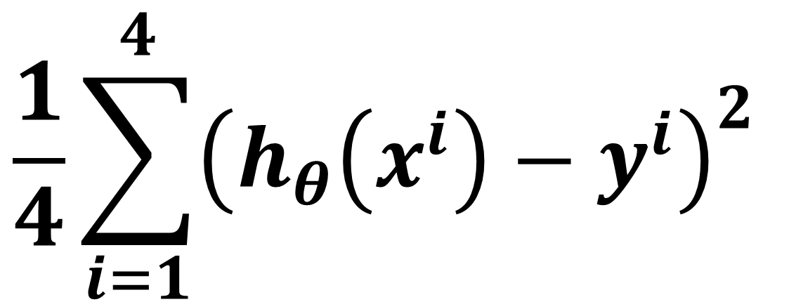
$$θ_{0}$$
$$θ_{1}$$
$$\frac{∂}{∂θ_{0}}J(θ_{0},θ_{1})$$
$$\frac{∂}{∂θ_{1}}J(θ_{0},θ_{1})$$
450 | 0.15
$$\frac{1}{4}\sum_{i=1}^{4}{\left({h_{θ}\left(x^{i}\right)−y}^{i}\right)}$$
$$\frac{1}{4}\sum_{i=1}^{4}{\left({h_{θ}\left(x^{i}\right)−y}^{i}\right)\text{. }x^{i} }$$
$$\frac{1}{4}\sum_{i=1}^{4}{{\left({h_{θ}\left(x^{i}\right)−y}^{i}\right)}^{2} }$$
$$\sum_{i=1}^{4}{{\left({h_{θ}\left(x^{i}\right)−y}^{i}\right)}^{2} }$$
$$θ_{0}−α×\frac{∂}{∂θ_{0}}J(θ_{0},θ_{1})$$
$${\left({h_{θ}\left(x^{i}\right)−y}^{i}\right)}^{2}$$
$$α×\frac{∂}{∂θ_{0}}J(θ_{0},θ_{1})$$
$$h_{θ}(x^{i})$$
$$y^{i}$$
$$\left({h_{θ}\left(x^{i}\right)−y}^{i}\right)$$
1 | 2104
1 | 1416
1 | 1534
1 | 852
765.6
662.4
680.1
577.8
400
232
315
178
365.6
430.4
365.1
399.8
133,663
184,900
133,225
159,840
$$α×\frac{∂}{∂θ_{1}}J(θ_{0},θ_{1})$$
$$θ_{1}−α×\frac{∂}{∂θ_{1}}J(θ_{0},θ_{1})$$
611,628
74,453
divide by m

Slide 36
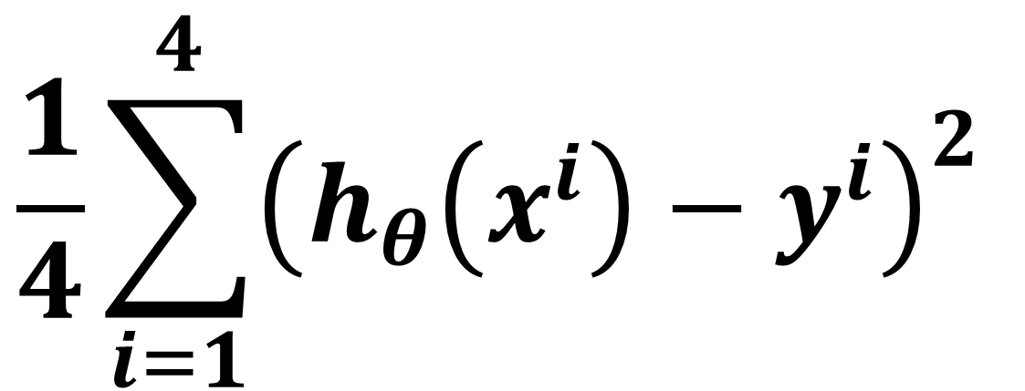
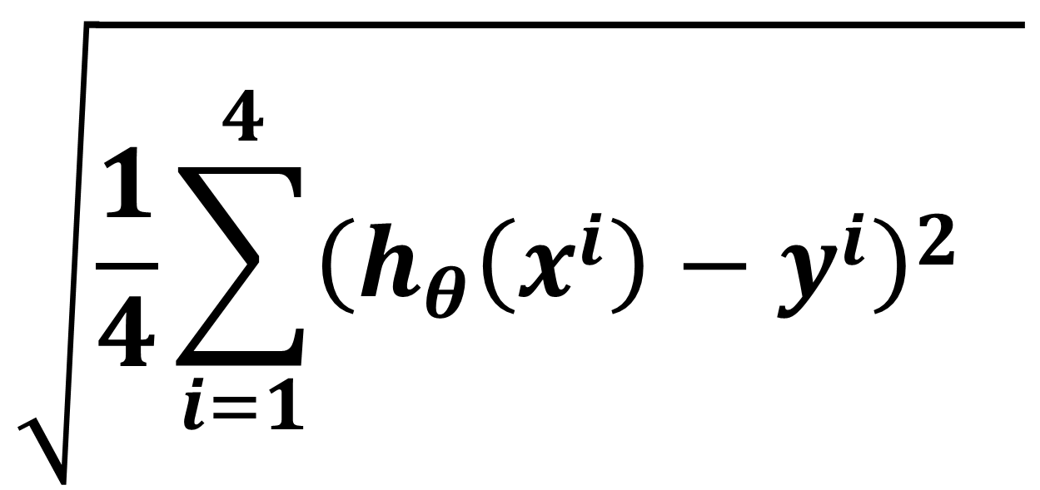
$$θ_{0}$$
$$θ_{1}$$
$$\frac{∂}{∂θ_{0}}J(θ_{0},θ_{1})$$
$$\frac{∂}{∂θ_{1}}J(θ_{0},θ_{1})$$
450 | 0.15
$$\frac{1}{4}\sum_{i=1}^{4}{\left({h_{θ}\left(x^{i}\right)−y}^{i}\right)}$$
$$\frac{1}{4}\sum_{i=1}^{4}{\left({h_{θ}\left(x^{i}\right)−y}^{i}\right)\text{. }x^{i} }$$
$$\sqrt{\frac{1}{4}\sum_{i=1}^{4}{{\left({h_{θ}\left(x^{i}\right)−y}^{i}\right)}^{2} } }$$
$$\sum_{i=1}^{4}{{\left({h_{θ}\left(x^{i}\right)−y}^{i}\right)}^{2} }$$
$$\frac{1}{4}\sum_{i=1}^{4}{{\left({h_{θ}\left(x^{i}\right)−y}^{i}\right)}^{2} }$$
$$θ_{0}−α×\frac{∂}{∂θ_{0}}J(θ_{0},θ_{1})$$
$${\left({h_{θ}\left(x^{i}\right)−y}^{i}\right)}^{2}$$
$$α×\frac{∂}{∂θ_{0}}J(θ_{0},θ_{1})$$
$$h_{θ}(x^{i})$$
$$y^{i}$$
$$\left({h_{θ}\left(x^{i}\right)−y}^{i}\right)$$
1 | 2104
1 | 1416
1 | 1534
1 | 852
765.6
662.4
680.1
577.8
400
232
315
178
365.6
430.4
365.1
399.8
133,663
184,900
133,225
159,840
$$α×\frac{∂}{∂θ_{1}}J(θ_{0},θ_{1})$$
$$θ_{1}−α×\frac{∂}{∂θ_{1}}J(θ_{0},θ_{1})$$
611,628
74,453
276.50
divide by m
Take Square Root

Slide 37
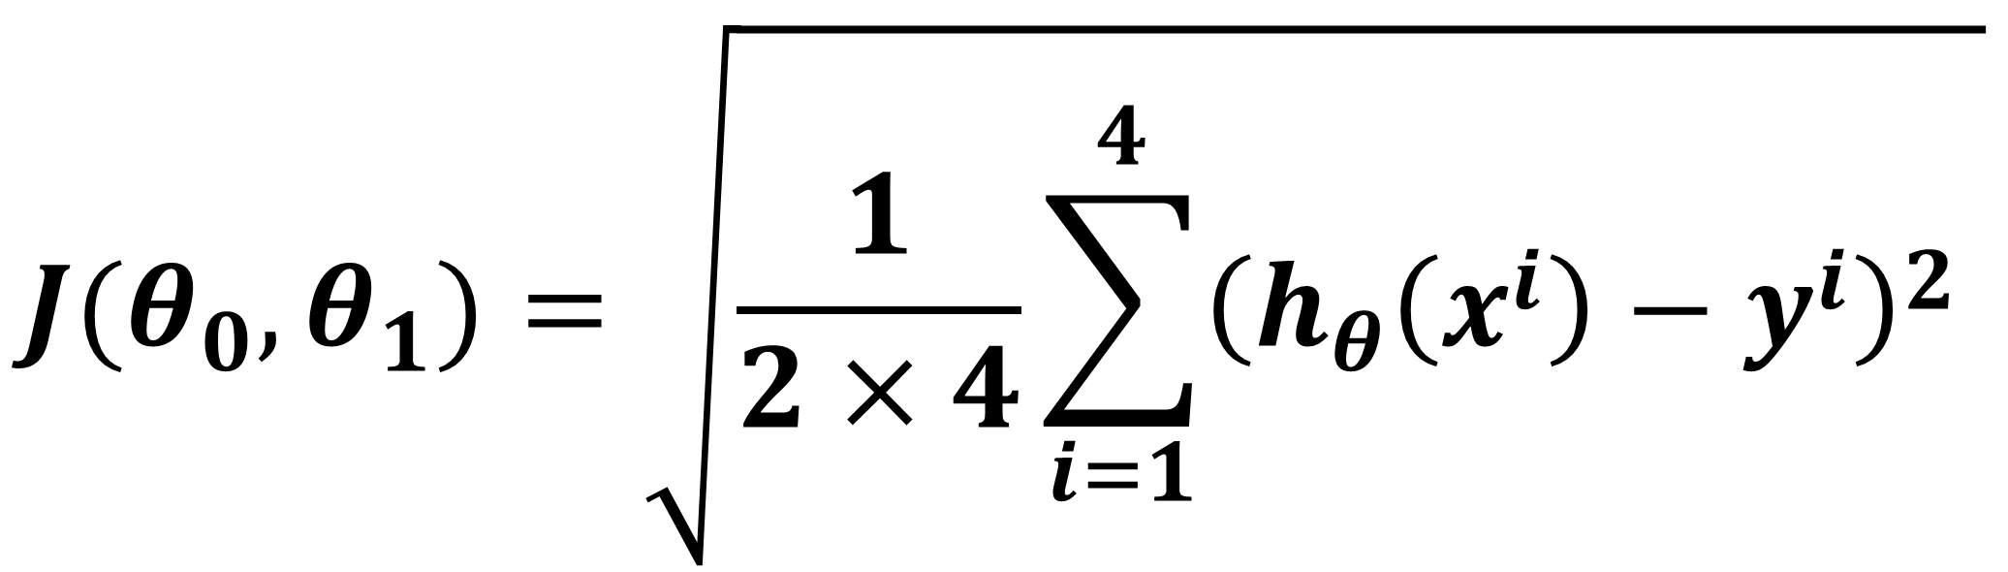
$$θ_{0}$$
$$θ_{1}$$
$$\frac{∂}{∂θ_{0}}J(θ_{0},θ_{1})$$
$$\frac{∂}{∂θ_{1}}J(θ_{0},θ_{1})$$
450 | 0.15
RMSE using values of THETA_0 and THETA_1
$$\frac{1}{4}\sum_{i=1}^{4}{\left({h_{θ}\left(x^{i}\right)−y}^{i}\right)}$$
$$\frac{1}{4}\sum_{i=1}^{4}{\left({h_{θ}\left(x^{i}\right)−y}^{i}\right)\text{. }x^{i} }$$
$$J(θ_{0},θ_{1})=\sqrt{\frac{1}{2×4}\sum_{i=1}^{4}{{\left({h_{θ}\left(x^{i}\right)−y}^{i}\right)}^{2} }}$$
$$\sum_{i=1}^{4}{{\left({h_{θ}\left(x^{i}\right)−y}^{i}\right)}^{2} }$$
$$θ_{0}−α×\frac{∂}{∂θ_{0}}J(θ_{0},θ_{1})$$
$${\left({h_{θ}\left(x^{i}\right)−y}^{i}\right)}^{2}$$
$$α×\frac{∂}{∂θ_{0}}J(θ_{0},θ_{1})$$
$$h_{θ}(x^{i})$$
$$y^{i}$$
$$\left({h_{θ}\left(x^{i}\right)−y}^{i}\right)$$
1 | 2104
1 | 1416
1 | 1534
1 | 852
765.6
662.4
680.1
577.8
400
232
315
178
365.6
430.4
365.1
399.8
133,663
184,900
133,225
159,840
$$α×\frac{∂}{∂θ_{1}}J(θ_{0},θ_{1})$$
$$θ_{1}−α×\frac{∂}{∂θ_{1}}J(θ_{0},θ_{1})$$
611,628
74,453

Slide 38
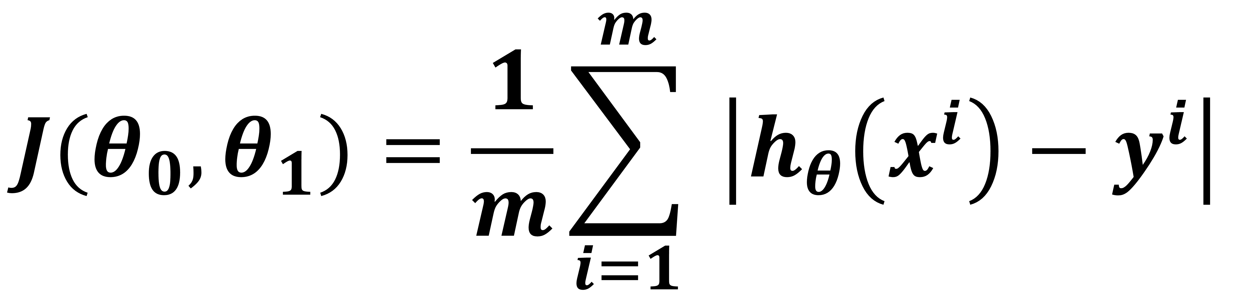
Mean Absolute Error Calculation (MAE)
$$J(θ_{0},θ_{1})=\frac{1}{m}\sum_{i=1}^{m}{ \left|{h_{θ}\left(x^{i}\right)−y}^{i}\right|}$$

Slide 39
$$θ_{0}$$
$$θ_{1}$$
$$\frac{∂}{∂θ_{0}}J(θ_{0},θ_{1})$$
$$\frac{∂}{∂θ_{1}}J(θ_{0},θ_{1})$$
450 | 0.15
$$\frac{1}{4}\sum_{i=1}^{4}{\left({h_{θ}\left(x^{i}\right)−y}^{i}\right)}$$
$$\frac{1}{4}\sum_{i=1}^{4}{\left({h_{θ}\left(x^{i}\right)−y}^{i}\right)\text{. }x^{i} }$$
$$α×\frac{∂}{∂θ_{0}}J(θ_{0},θ_{1})$$
$$θ_{0}−α×\frac{∂}{∂θ_{0}}J(θ_{0},θ_{1})$$
$$h_{θ}(x^{i})$$
$$y^{i}$$
$$\left({h_{θ}\left(x^{i}\right)−y}^{i}\right)$$
$$y^{i}$$
1 | 2104
1 | 1416
1 | 1534
1 | 852
400
232
315
178
400
232
315
178
$$α×\frac{∂}{∂θ_{1}}J(θ_{0},θ_{1})$$
$$θ_{1}−α×\frac{∂}{∂θ_{1}}J(θ_{0},θ_{1})$$

Slide 40
$$θ_{0}$$
$$θ_{1}$$
$$\frac{∂}{∂θ_{0}}J(θ_{0},θ_{1})$$
$$\frac{∂}{∂θ_{1}}J(θ_{0},θ_{1})$$
450 | 0.15
$$\frac{1}{4}\sum_{i=1}^{4}{\left({h_{θ}\left(x^{i}\right)−y}^{i}\right)}$$
$$\frac{1}{4}\sum_{i=1}^{4}{\left({h_{θ}\left(x^{i}\right)−y}^{i}\right)\text{. }x^{i} }$$
$$α×\frac{∂}{∂θ_{0}}J(θ_{0},θ_{1})$$
$$θ_{0}−α×\frac{∂}{∂θ_{0}}J(θ_{0},θ_{1})$$
$$h_{θ}(x^{i})$$
$$y^{i}$$
$$\left({h_{θ}\left(x^{i}\right)−y}^{i}\right)$$
1 | 2104
1 | 1416
1 | 1534
1 | 852
400
232
315
178
$$α×\frac{∂}{∂θ_{1}}J(θ_{0},θ_{1})$$
$$θ_{1}−α×\frac{∂}{∂θ_{1}}J(θ_{0},θ_{1})$$

Slide 41
$$θ_{0}$$
$$θ_{1}$$
$$\frac{∂}{∂θ_{0}}J(θ_{0},θ_{1})$$
$$\frac{∂}{∂θ_{1}}J(θ_{0},θ_{1})$$
450 | 0.15
$$\frac{1}{4}\sum_{i=1}^{4}{\left({h_{θ}\left(x^{i}\right)−y}^{i}\right)}$$
$$\frac{1}{4}\sum_{i=1}^{4}{\left({h_{θ}\left(x^{i}\right)−y}^{i}\right)\text{. }x^{i} }$$
$$α×\frac{∂}{∂θ_{0}}J(θ_{0},θ_{1})$$
$$θ_{0}−α×\frac{∂}{∂θ_{0}}J(θ_{0},θ_{1})$$
$$×$$
$$×$$
$$h_{θ}(x^{i})$$
$$y^{i}$$
$$\left({h_{θ}\left(x^{i}\right)−y}^{i}\right)$$
1 | 2104
1 | 1416
1 | 1534
1 | 852
400
232
315
178
$$α×\frac{∂}{∂θ_{1}}J(θ_{0},θ_{1})$$
$$θ_{1}−α×\frac{∂}{∂θ_{1}}J(θ_{0},θ_{1})$$

Slide 42
$$θ_{0}$$
$$θ_{1}$$
$$\frac{∂}{∂θ_{0}}J(θ_{0},θ_{1})$$
$$\frac{∂}{∂θ_{1}}J(θ_{0},θ_{1})$$
450 | 0.15
$$\frac{1}{4}\sum_{i=1}^{4}{\left({h_{θ}\left(x^{i}\right)−y}^{i}\right)}$$
$$\frac{1}{4}\sum_{i=1}^{4}{\left({h_{θ}\left(x^{i}\right)−y}^{i}\right)\text{. }x^{i} }$$
$$α×\frac{∂}{∂θ_{0}}J(θ_{0},θ_{1})$$
$$θ_{0}−α×\frac{∂}{∂θ_{0}}J(θ_{0},θ_{1})$$
$$×$$
$$×$$
$$h_{θ}(x^{i})$$
$$y^{i}$$
$$\left({h_{θ}\left(x^{i}\right)−y}^{i}\right)$$
1 | 2104
1 | 1416
1 | 1534
1 | 852
$$+$$
450+315.6
400
232
315
178
$$α×\frac{∂}{∂θ_{1}}J(θ_{0},θ_{1})$$
$$θ_{1}−α×\frac{∂}{∂θ_{1}}J(θ_{0},θ_{1})$$

Slide 43
$$θ_{0}$$
$$θ_{1}$$
$$\frac{∂}{∂θ_{0}}J(θ_{0},θ_{1})$$
$$\frac{∂}{∂θ_{1}}J(θ_{0},θ_{1})$$
450 | 0.15
$$\frac{1}{4}\sum_{i=1}^{4}{\left({h_{θ}\left(x^{i}\right)−y}^{i}\right)}$$
$$\frac{1}{4}\sum_{i=1}^{4}{\left({h_{θ}\left(x^{i}\right)−y}^{i}\right)\text{. }x^{i} }$$
$$α×\frac{∂}{∂θ_{0}}J(θ_{0},θ_{1})$$
$$θ_{0}−α×\frac{∂}{∂θ_{0}}J(θ_{0},θ_{1})$$
$$×$$
$$×$$
$$h_{θ}(x^{i})$$
$$y^{i}$$
$$\left({h_{θ}\left(x^{i}\right)−y}^{i}\right)$$
1 | 2104
1 | 1416
1 | 1534
1 | 852
$$+$$
765.6
400
232
315
178
$$α×\frac{∂}{∂θ_{1}}J(θ_{0},θ_{1})$$
$$θ_{1}−α×\frac{∂}{∂θ_{1}}J(θ_{0},θ_{1})$$

Slide 44
$$θ_{0}$$
$$θ_{1}$$
$$\frac{∂}{∂θ_{0}}J(θ_{0},θ_{1})$$
$$\frac{∂}{∂θ_{1}}J(θ_{0},θ_{1})$$
450 | 0.15
$$\frac{1}{4}\sum_{i=1}^{4}{\left({h_{θ}\left(x^{i}\right)−y}^{i}\right)}$$
$$\frac{1}{4}\sum_{i=1}^{4}{\left({h_{θ}\left(x^{i}\right)−y}^{i}\right)\text{. }x^{i} }$$
$$α×\frac{∂}{∂θ_{0}}J(θ_{0},θ_{1})$$
$$θ_{0}−α×\frac{∂}{∂θ_{0}}J(θ_{0},θ_{1})$$
$$×$$
$$×$$
$$h_{θ}(x^{i})$$
$$y^{i}$$
$$\left({h_{θ}\left(x^{i}\right)−y}^{i}\right)$$
1 | 2104
1 | 1416
1 | 1534
1 | 852
765.6
400
232
315
178
$$α×\frac{∂}{∂θ_{1}}J(θ_{0},θ_{1})$$
$$θ_{1}−α×\frac{∂}{∂θ_{1}}J(θ_{0},θ_{1})$$

Slide 45
$$θ_{0}$$
$$θ_{1}$$
$$\frac{∂}{∂θ_{0}}J(θ_{0},θ_{1})$$
$$\frac{∂}{∂θ_{1}}J(θ_{0},θ_{1})$$
450 | 0.15
$$\frac{1}{4}\sum_{i=1}^{4}{\left({h_{θ}\left(x^{i}\right)−y}^{i}\right)}$$
$$\frac{1}{4}\sum_{i=1}^{4}{\left({h_{θ}\left(x^{i}\right)−y}^{i}\right)\text{. }x^{i} }$$
$$α×\frac{∂}{∂θ_{0}}J(θ_{0},θ_{1})$$
$$θ_{0}−α×\frac{∂}{∂θ_{0}}J(θ_{0},θ_{1})$$
$$×$$
$$×$$
$$h_{θ}(x^{i})$$
$$y^{i}$$
$$\left({h_{θ}\left(x^{i}\right)−y}^{i}\right)$$
1 | 2104
1 | 1416
1 | 1534
1 | 852
765.6
662.4
400
232
315
178
$$α×\frac{∂}{∂θ_{1}}J(θ_{0},θ_{1})$$
$$θ_{1}−α×\frac{∂}{∂θ_{1}}J(θ_{0},θ_{1})$$
$$+$$

Slide 46
$$θ_{0}$$
$$θ_{1}$$
$$\frac{∂}{∂θ_{0}}J(θ_{0},θ_{1})$$
$$\frac{∂}{∂θ_{1}}J(θ_{0},θ_{1})$$
450 | 0.15
$$\frac{1}{4}\sum_{i=1}^{4}{\left({h_{θ}\left(x^{i}\right)−y}^{i}\right)}$$
$$\frac{1}{4}\sum_{i=1}^{4}{\left({h_{θ}\left(x^{i}\right)−y}^{i}\right)\text{. }x^{i} }$$
$$α×\frac{∂}{∂θ_{0}}J(θ_{0},θ_{1})$$
$$θ_{0}−α×\frac{∂}{∂θ_{0}}J(θ_{0},θ_{1})$$
$$×$$
$$×$$
$$h_{θ}(x^{i})$$
$$y^{i}$$
$$\left({h_{θ}\left(x^{i}\right)−y}^{i}\right)$$
1 | 2104
1 | 1416
1 | 1534
1 | 852
765.6
662.4
400
232
315
178
$$α×\frac{∂}{∂θ_{1}}J(θ_{0},θ_{1})$$
$$θ_{1}−α×\frac{∂}{∂θ_{1}}J(θ_{0},θ_{1})$$

Slide 47
$$θ_{0}$$
$$θ_{1}$$
$$\frac{∂}{∂θ_{0}}J(θ_{0},θ_{1})$$
$$\frac{∂}{∂θ_{1}}J(θ_{0},θ_{1})$$
450 | 0.15
$$\frac{1}{4}\sum_{i=1}^{4}{\left({h_{θ}\left(x^{i}\right)−y}^{i}\right)}$$
$$\frac{1}{4}\sum_{i=1}^{4}{\left({h_{θ}\left(x^{i}\right)−y}^{i}\right)\text{. }x^{i} }$$
$$α×\frac{∂}{∂θ_{0}}J(θ_{0},θ_{1})$$
$$θ_{0}−α×\frac{∂}{∂θ_{0}}J(θ_{0},θ_{1})$$
$$×$$
$$×$$
$$h_{θ}(x^{i})$$
$$y^{i}$$
$$\left({h_{θ}\left(x^{i}\right)−y}^{i}\right)$$
1 | 2104
1 | 1416
1 | 1534
1 | 852
765.6
662.4
680.1
400
232
315
178
$$α×\frac{∂}{∂θ_{1}}J(θ_{0},θ_{1})$$
$$θ_{1}−α×\frac{∂}{∂θ_{1}}J(θ_{0},θ_{1})$$
$$+$$

Slide 48
$$θ_{0}$$
$$θ_{1}$$
$$\frac{∂}{∂θ_{0}}J(θ_{0},θ_{1})$$
$$\frac{∂}{∂θ_{1}}J(θ_{0},θ_{1})$$
450 | 0.15
$$\frac{1}{4}\sum_{i=1}^{4}{\left({h_{θ}\left(x^{i}\right)−y}^{i}\right)}$$
$$\frac{1}{4}\sum_{i=1}^{4}{\left({h_{θ}\left(x^{i}\right)−y}^{i}\right)\text{. }x^{i} }$$
$$α×\frac{∂}{∂θ_{0}}J(θ_{0},θ_{1})$$
$$θ_{0}−α×\frac{∂}{∂θ_{0}}J(θ_{0},θ_{1})$$
$$×$$
$$×$$
$$h_{θ}(x^{i})$$
$$y^{i}$$
$$\left({h_{θ}\left(x^{i}\right)−y}^{i}\right)$$
1 | 2104
1 | 1416
1 | 1534
1 | 852
765.6
662.4
680.1
400
232
315
178
$$α×\frac{∂}{∂θ_{1}}J(θ_{0},θ_{1})$$
$$θ_{1}−α×\frac{∂}{∂θ_{1}}J(θ_{0},θ_{1})$$

Slide 49
$$θ_{0}$$
$$θ_{1}$$
$$\frac{∂}{∂θ_{0}}J(θ_{0},θ_{1})$$
$$\frac{∂}{∂θ_{1}}J(θ_{0},θ_{1})$$
450 | 0.15
$$\frac{1}{4}\sum_{i=1}^{4}{\left({h_{θ}\left(x^{i}\right)−y}^{i}\right)}$$
$$\frac{1}{4}\sum_{i=1}^{4}{\left({h_{θ}\left(x^{i}\right)−y}^{i}\right)\text{. }x^{i} }$$
$$α×\frac{∂}{∂θ_{0}}J(θ_{0},θ_{1})$$
$$θ_{0}−α×\frac{∂}{∂θ_{0}}J(θ_{0},θ_{1})$$
$$×$$
$$×$$
$$h_{θ}(x^{i})$$
$$y^{i}$$
$$\left({h_{θ}\left(x^{i}\right)−y}^{i}\right)$$
1 | 2104
1 | 1416
1 | 1534
1 | 852
765.6
662.4
680.1
577.8
400
232
315
178
$$α×\frac{∂}{∂θ_{1}}J(θ_{0},θ_{1})$$
$$θ_{1}−α×\frac{∂}{∂θ_{1}}J(θ_{0},θ_{1})$$
$$+$$

Slide 50
$$θ_{0}$$
$$θ_{1}$$
$$\frac{∂}{∂θ_{0}}J(θ_{0},θ_{1})$$
$$\frac{∂}{∂θ_{1}}J(θ_{0},θ_{1})$$
450 | 0.15
$$\frac{1}{4}\sum_{i=1}^{4}{\left({h_{θ}\left(x^{i}\right)−y}^{i}\right)}$$
$$\frac{1}{4}\sum_{i=1}^{4}{\left({h_{θ}\left(x^{i}\right)−y}^{i}\right)\text{. }x^{i} }$$
$$α×\frac{∂}{∂θ_{0}}J(θ_{0},θ_{1})$$
$$θ_{0}−α×\frac{∂}{∂θ_{0}}J(θ_{0},θ_{1})$$
$$h_{θ}(x^{i})$$
$$y^{i}$$
$$\left({h_{θ}\left(x^{i}\right)−y}^{i}\right)$$
1 | 2104
1 | 1416
1 | 1534
1 | 852
765.6
662.4
680.1
577.8
400
232
315
178
$$α×\frac{∂}{∂θ_{1}}J(θ_{0},θ_{1})$$
$$θ_{1}−α×\frac{∂}{∂θ_{1}}J(θ_{0},θ_{1})$$

Slide 51
$$θ_{0}$$
$$θ_{1}$$
$$\frac{∂}{∂θ_{0}}J(θ_{0},θ_{1})$$
$$\frac{∂}{∂θ_{1}}J(θ_{0},θ_{1})$$
450 | 0.15
$$\frac{1}{4}\sum_{i=1}^{4}{\left({h_{θ}\left(x^{i}\right)−y}^{i}\right)}$$
$$\frac{1}{4}\sum_{i=1}^{4}{\left({h_{θ}\left(x^{i}\right)−y}^{i}\right)\text{. }x^{i} }$$
$$α×\frac{∂}{∂θ_{0}}J(θ_{0},θ_{1})$$
$$θ_{0}−α×\frac{∂}{∂θ_{0}}J(θ_{0},θ_{1})$$
$$h_{θ}(x^{i})$$
$$y^{i}$$
$$\left({h_{θ}\left(x^{i}\right)−y}^{i}\right)$$
1 | 2104
1 | 1416
1 | 1534
1 | 852
765.6
662.4
680.1
577.8
400
232
315
178
$$−$$
365.6
430.4
365.1
399.8
$$α×\frac{∂}{∂θ_{1}}J(θ_{0},θ_{1})$$
$$θ_{1}−α×\frac{∂}{∂θ_{1}}J(θ_{0},θ_{1})$$
$$−$$
$$−$$
$$−$$

Slide 52
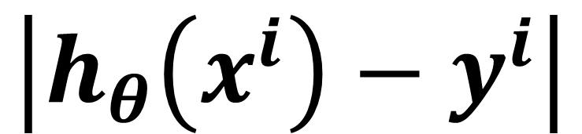
$$θ_{0}$$
$$θ_{1}$$
$$\frac{∂}{∂θ_{0}}J(θ_{0},θ_{1})$$
$$\frac{∂}{∂θ_{1}}J(θ_{0},θ_{1})$$
450 | 0.15
$$\frac{1}{4}\sum_{i=1}^{4}{\left({h_{θ}\left(x^{i}\right)−y}^{i}\right)}$$
$$\frac{1}{4}\sum_{i=1}^{4}{\left({h_{θ}\left(x^{i}\right)−y}^{i}\right)\text{. }x^{i} }$$
$$α×\frac{∂}{∂θ_{0}}J(θ_{0},θ_{1})$$
$$θ_{0}−α×\frac{∂}{∂θ_{0}}J(θ_{0},θ_{1})$$
$$h_{θ}(x^{i})$$
$$y^{i}$$
$$\left({h_{θ}\left(x^{i}\right)−y}^{i}\right)$$
$$\left|{h_{θ}\left(x^{i}\right)−y}^{i}\right|$$
1 | 2104
1 | 1416
1 | 1534
1 | 852
765.6
662.4
680.1
577.8
400
232
315
178
365.6
430.4
365.1
399.8
365.5
430.4
365.1
399.8
$$α×\frac{∂}{∂θ_{1}}J(θ_{0},θ_{1})$$
Absolute
$$θ_{1}−α×\frac{∂}{∂θ_{1}}J(θ_{0},θ_{1})$$
Absolute
Absolute
Absolute

Slide 53
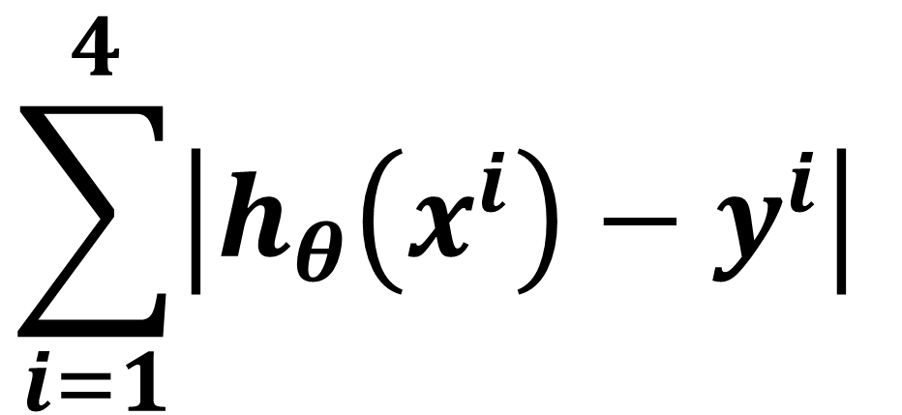
$$θ_{0}$$
$$θ_{1}$$
$$\frac{∂}{∂θ_{0}}J(θ_{0},θ_{1})$$
$$\frac{∂}{∂θ_{1}}J(θ_{0},θ_{1})$$
450 | 0.15
$$\frac{1}{4}\sum_{i=1}^{4}{\left({h_{θ}\left(x^{i}\right)−y}^{i}\right)}$$
$$\frac{1}{4}\sum_{i=1}^{4}{\left({h_{θ}\left(x^{i}\right)−y}^{i}\right)\text{. }x^{i} }$$
$$\sum_{i=1}^{4}{\left|{h_{θ}\left(x^{i}\right)−y}^{i}\right| }$$
$$θ_{0}−α×\frac{∂}{∂θ_{0}}J(θ_{0},θ_{1})$$
$$α×\frac{∂}{∂θ_{0}}J(θ_{0},θ_{1})$$
$$h_{θ}(x^{i})$$
$$y^{i}$$
$$\left({h_{θ}\left(x^{i}\right)−y}^{i}\right)$$
$$\left|{h_{θ}\left(x^{i}\right)−y}^{i}\right|$$
1 | 2104
1 | 1416
1 | 1534
1 | 852
765.6
662.4
680.1
577.8
400
232
315
178
365.6
430.4
365.1
399.8
365.5
430.4
365.1
399.8
$$α×\frac{∂}{∂θ_{1}}J(θ_{0},θ_{1})$$
$$θ_{1}−α×\frac{∂}{∂θ_{1}}J(θ_{0},θ_{1})$$
sum
1560.8
sum
sum
sum

Slide 54
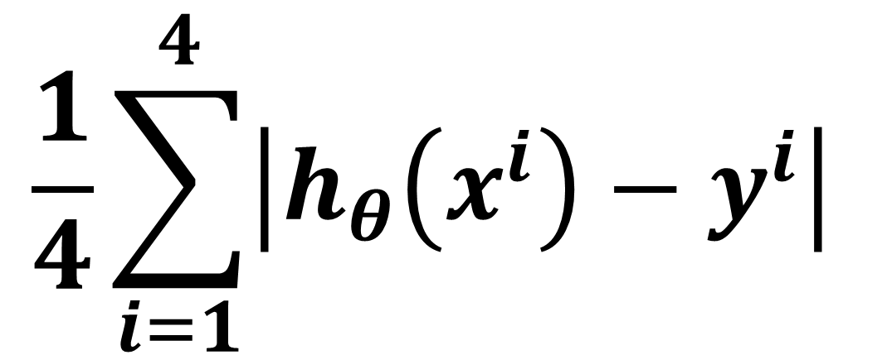
$$θ_{0}$$
$$θ_{1}$$
$$\frac{∂}{∂θ_{0}}J(θ_{0},θ_{1})$$
$$\frac{∂}{∂θ_{1}}J(θ_{0},θ_{1})$$
450 | 0.15
$$\frac{1}{4}\sum_{i=1}^{4}{\left({h_{θ}\left(x^{i}\right)−y}^{i}\right)}$$
$$\frac{1}{4}\sum_{i=1}^{4}{\left({h_{θ}\left(x^{i}\right)−y}^{i}\right)\text{. }x^{i} }$$
$$\sum_{i=1}^{4}{\left|{h_{θ}\left(x^{i}\right)−y}^{i}\right| }$$
$$\frac{1}{4}\sum_{i=1}^{4}{\left|{h_{θ}\left(x^{i}\right)−y}^{i}\right| }$$
$$θ_{0}−α×\frac{∂}{∂θ_{0}}J(θ_{0},θ_{1})$$
$$α×\frac{∂}{∂θ_{0}}J(θ_{0},θ_{1})$$
$$h_{θ}(x^{i})$$
$$y^{i}$$
$$\left({h_{θ}\left(x^{i}\right)−y}^{i}\right)$$
$$\left|{h_{θ}\left(x^{i}\right)−y}^{i}\right|$$
1 | 2104
1 | 1416
1 | 1534
1 | 852
765.6
662.4
680.1
577.8
400
232
315
178
365.6
430.4
365.1
399.8
133,663
184,900
133,225
159,840
$$α×\frac{∂}{∂θ_{1}}J(θ_{0},θ_{1})$$
$$θ_{1}−α×\frac{∂}{∂θ_{1}}J(θ_{0},θ_{1})$$
1560.8
390.2
divide by m

Slide 55
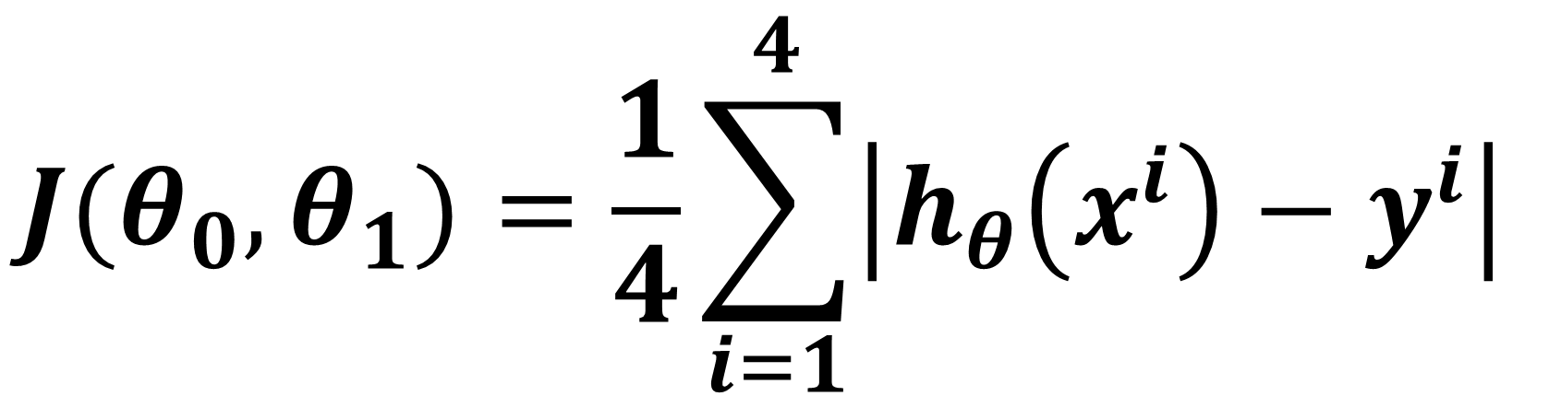
$$θ_{0}$$
$$θ_{1}$$
$$\frac{∂}{∂θ_{0}}J(θ_{0},θ_{1})$$
$$\frac{∂}{∂θ_{1}}J(θ_{0},θ_{1})$$
450 | 0.15
MAE using values of THETA_0 and THETA_1
$$\frac{1}{4}\sum_{i=1}^{4}{\left({h_{θ}\left(x^{i}\right)−y}^{i}\right)}$$
$$\frac{1}{4}\sum_{i=1}^{4}{\left({h_{θ}\left(x^{i}\right)−y}^{i}\right)\text{. }x^{i} }$$
$$J(θ_{0},θ_{1})=\frac{1}{4}\sum_{i=1}^{4}{\left|{h_{θ}\left(x^{i}\right)−y}^{i}\right| }$$
$$\sum_{i=1}^{4}{\left|{h_{θ}\left(x^{i}\right)−y}^{i}\right| }$$
$$θ_{0}−α×\frac{∂}{∂θ_{0}}J(θ_{0},θ_{1})$$
$$α×\frac{∂}{∂θ_{0}}J(θ_{0},θ_{1})$$
$$h_{θ}(x^{i})$$
$$y^{i}$$
$$\left({h_{θ}\left(x^{i}\right)−y}^{i}\right)$$
$$\left|{h_{θ}\left(x^{i}\right)−y}^{i}\right|$$
1 | 2104
1 | 1416
1 | 1534
1 | 852
765.6
662.4
680.1
577.8
400
232
315
178
365.6
430.4
365.1
399.8
133,663
184,900
133,225
159,840
$$α×\frac{∂}{∂θ_{1}}J(θ_{0},θ_{1})$$
$$θ_{1}−α×\frac{∂}{∂θ_{1}}J(θ_{0},θ_{1})$$
1560.8
390.2

Slide 56
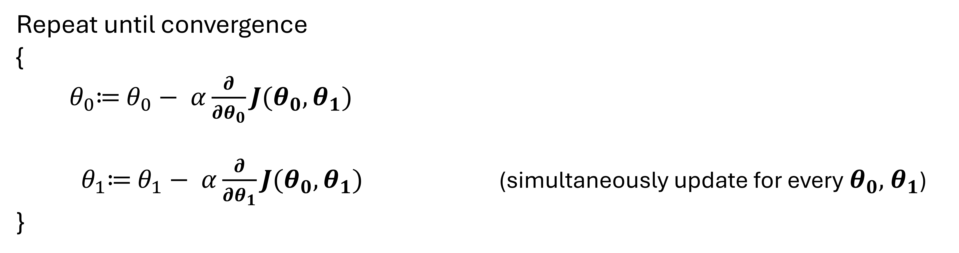
Gradient Descent
Repeat until convergence
{
${ θ}_{0}≔$ $θ_{0}− α\frac{∂}{∂θ_{0}}J(θ_{0},θ_{1})$
${ θ}_{1}≔$ $θ_{1}− α\frac{∂}{∂θ_{1}}J(θ_{0},θ_{1})$ (simultaneously update for every${ θ}_{0},{ θ}_{1}$)
}

Slide 57
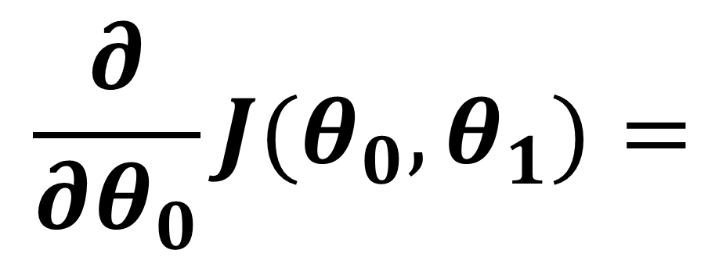
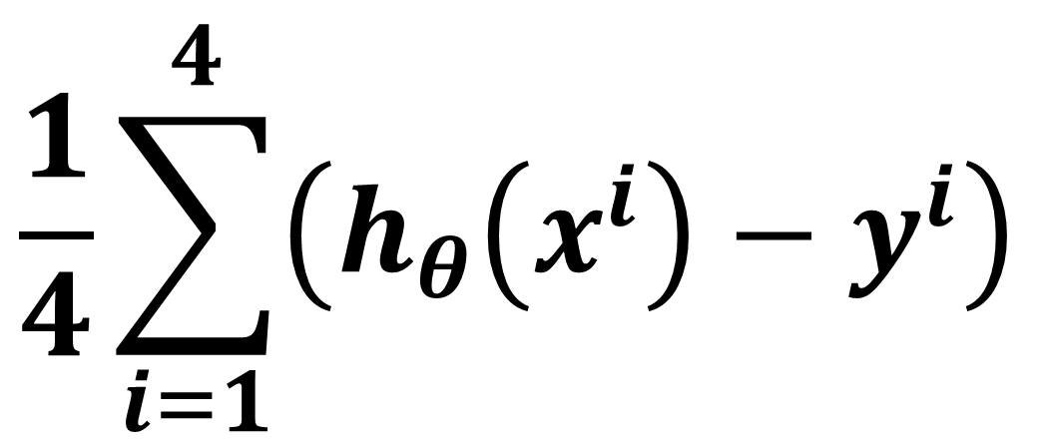
$$\frac{∂}{∂θ_{0}}J(θ_{0},θ_{1})=$$
$$\frac{1}{4}\sum_{i=1}^{4}{\left({h_{θ}\left(x^{i}\right)−y}^{i}\right)}$$
$$θ_{0}$$
$$θ_{1}$$
$$\frac{∂}{∂θ_{1}}J(θ_{0},θ_{1})$$
450 | 0.15
$$\frac{1}{4}\sum_{i=1}^{4}{\left({h_{θ}\left(x^{i}\right)−y}^{i}\right)\text{. }x^{i} }$$
$$α×\frac{∂}{∂θ_{0}}J(θ_{0},θ_{1})$$
$$θ_{0}−α×\frac{∂}{∂θ_{0}}J(θ_{0},θ_{1})$$
$$h_{θ}(x^{i})$$
$$y^{i}$$
$$\left({h_{θ}\left(x^{i}\right)−y}^{i}\right)$$
1 | 2104
1 | 1416
1 | 1534
1 | 852
765.6
662.4
680.1
577.8
400
232
315
178
365.6
430.4
365.1
399.8
$$α×\frac{∂}{∂θ_{1}}J(θ_{0},θ_{1})$$
$$θ_{1}−α×\frac{∂}{∂θ_{1}}J(θ_{0},θ_{1})$$

Slide 58
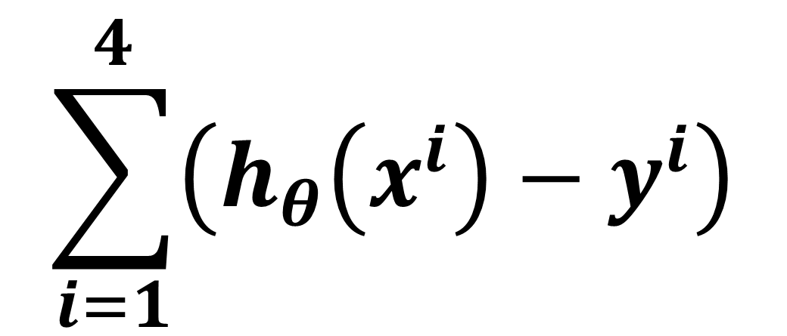
$$\frac{∂}{∂θ_{0}}J(θ_{0},θ_{1})=$$
$$\frac{1}{4}\sum_{i=1}^{4}{\left({h_{θ}\left(x^{i}\right)−y}^{i}\right)}$$
$$θ_{0}$$
$$θ_{1}$$
$$\frac{∂}{∂θ_{1}}J(θ_{0},θ_{1})$$
450 | 0.15
$$\sum_{i=1}^{4}{\left({h_{θ}\left(x^{i}\right)−y}^{i}\right)}$$
$$\frac{1}{4}\sum_{i=1}^{4}{\left({h_{θ}\left(x^{i}\right)−y}^{i}\right)\text{. }x^{i} }$$
$$α×\frac{∂}{∂θ_{0}}J(θ_{0},θ_{1})$$
$$θ_{0}−α×\frac{∂}{∂θ_{0}}J(θ_{0},θ_{1})$$
$$h_{θ}(x^{i})$$
$$y^{i}$$
$$\left({h_{θ}\left(x^{i}\right)−y}^{i}\right)$$
1 | 2104
1 | 1416
1 | 1534
1 | 852
765.6
662.4
680.1
577.8
400
232
315
178
365.6
430.4
365.1
399.8
$$α×\frac{∂}{∂θ_{1}}J(θ_{0},θ_{1})$$
$$θ_{1}−α×\frac{∂}{∂θ_{1}}J(θ_{0},θ_{1})$$

Slide 59
$$\frac{∂}{∂θ_{0}}J(θ_{0},θ_{1})=$$
$$\frac{1}{4}\sum_{i=1}^{4}{\left({h_{θ}\left(x^{i}\right)−y}^{i}\right)}$$
$$θ_{0}$$
$$θ_{1}$$
$$\frac{∂}{∂θ_{1}}J(θ_{0},θ_{1})$$
450 | 0.15
$$\sum_{i=1}^{4}{\left({h_{θ}\left(x^{i}\right)−y}^{i}\right)}$$
$$\frac{1}{4}\sum_{i=1}^{4}{\left({h_{θ}\left(x^{i}\right)−y}^{i}\right)\text{. }x^{i} }$$
$$α×\frac{∂}{∂θ_{0}}J(θ_{0},θ_{1})$$
$$θ_{0}−α×\frac{∂}{∂θ_{0}}J(θ_{0},θ_{1})$$
$$h_{θ}(x^{i})$$
$$y^{i}$$
$$\left({h_{θ}\left(x^{i}\right)−y}^{i}\right)$$
1 | 2104
1 | 1416
1 | 1534
1 | 852
765.6
662.4
680.1
577.8
400
232
315
178
365.6
430.4
365.1
399.8
$$α×\frac{∂}{∂θ_{1}}J(θ_{0},θ_{1})$$
$$θ_{1}−α×\frac{∂}{∂θ_{1}}J(θ_{0},θ_{1})$$
sum
sum
1561
sum
sum

Slide 60
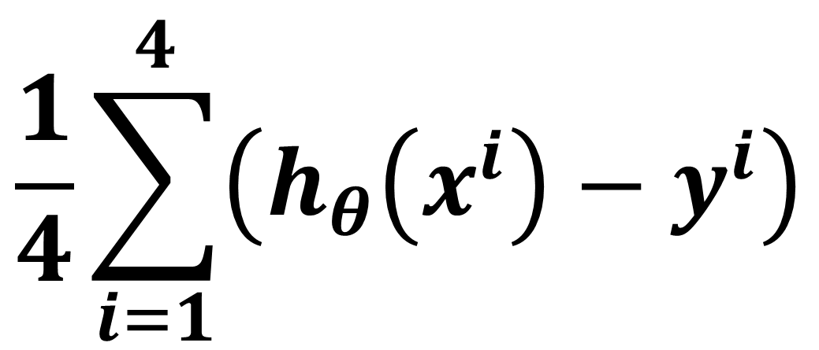
$$\frac{∂}{∂θ_{0}}J(θ_{0},θ_{1})=$$
$$\frac{1}{4}\sum_{i=1}^{4}{\left({h_{θ}\left(x^{i}\right)−y}^{i}\right)}$$
$$θ_{0}$$
$$θ_{1}$$
$$\frac{∂}{∂θ_{1}}J(θ_{0},θ_{1})$$
450 | 0.15
$$\frac{1}{4}\sum_{i=1}^{4}{\left({h_{θ}\left(x^{i}\right)−y}^{i}\right)\text{. }x^{i} }$$
$$\sum_{i=1}^{4}{\left({h_{θ}\left(x^{i}\right)−y}^{i}\right)}$$
$$\frac{1}{4}\sum_{i=1}^{4}{\left({h_{θ}\left(x^{i}\right)−y}^{i}\right)}$$
$$θ_{0}−α×\frac{∂}{∂θ_{0}}J(θ_{0},θ_{1})$$
$$α×\frac{∂}{∂θ_{0}}J(θ_{0},θ_{1})$$
$$h_{θ}(x^{i})$$
$$y^{i}$$
$$\left({h_{θ}\left(x^{i}\right)−y}^{i}\right)$$
1 | 2104
1 | 1416
1 | 1534
1 | 852
765.6
662.4
680.1
577.8
400
232
315
178
365.6
430.4
365.1
399.8
$$α×\frac{∂}{∂θ_{1}}J(θ_{0},θ_{1})$$
$$θ_{1}−α×\frac{∂}{∂θ_{1}}J(θ_{0},θ_{1})$$
sum
sum
1561
divide by m
390.25
sum
sum

Slide 61
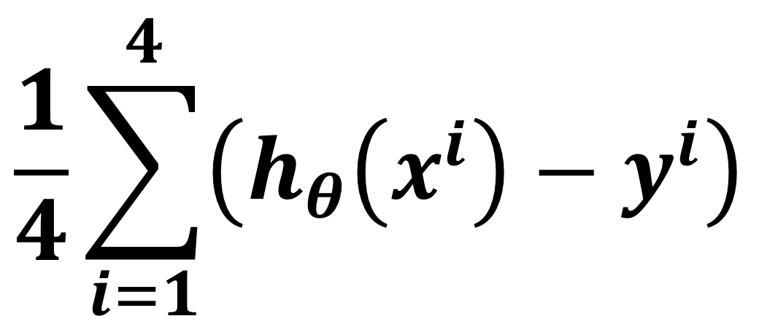
$$\frac{∂}{∂θ_{0}}J(θ_{0},θ_{1})=$$
$$\frac{1}{4}\sum_{i=1}^{4}{\left({h_{θ}\left(x^{i}\right)−y}^{i}\right)}$$
$$θ_{0}$$
$$θ_{1}$$
$$\frac{∂}{∂θ_{1}}J(θ_{0},θ_{1})$$
450 | 0.15
$$\frac{1}{4}\sum_{i=1}^{4}{\left({h_{θ}\left(x^{i}\right)−y}^{i}\right)}$$
$$\frac{1}{4}\sum_{i=1}^{4}{\left({h_{θ}\left(x^{i}\right)−y}^{i}\right)\text{. }x^{i} }$$
$$α×\frac{∂}{∂θ_{0}}J(θ_{0},θ_{1})$$
$$θ_{0}−α×\frac{∂}{∂θ_{0}}J(θ_{0},θ_{1})$$
$$h_{θ}(x^{i})$$
$$y^{i}$$
$$\left({h_{θ}\left(x^{i}\right)−y}^{i}\right)$$
1 | 2104
1 | 1416
1 | 1534
1 | 852
765.6
662.4
680.1
577.8
400
232
315
178
365.6
430.4
365.1
399.8
$$α×\frac{∂}{∂θ_{1}}J(θ_{0},θ_{1})$$
$$θ_{1}−α×\frac{∂}{∂θ_{1}}J(θ_{0},θ_{1})$$
390.25

Slide 62
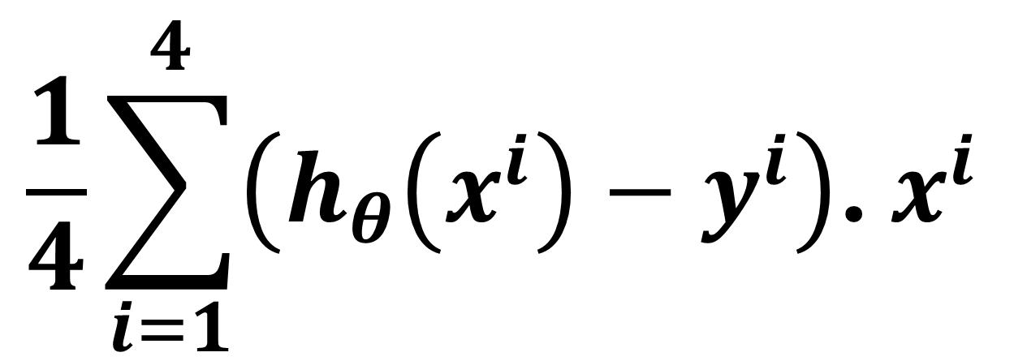
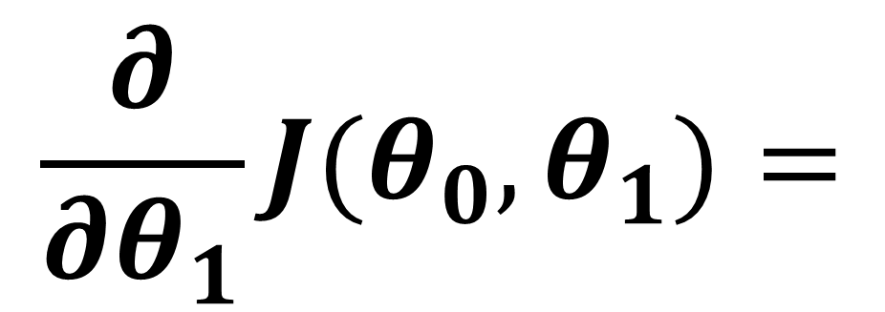
$$\frac{1}{4}\sum_{i=1}^{4}{\left({h_{θ}\left(x^{i}\right)−y}^{i}\right)}$$
$$\frac{1}{4}\sum_{i=1}^{4}{\left({h_{θ}\left(x^{i}\right)−y}^{i}\right)\text{. }x^{i} }$$
$$\frac{∂}{∂θ_{0}}J(θ_{0},θ_{1})=$$
390.25
$$\frac{∂}{∂θ_{1}}J(θ_{0},θ_{1})=$$
$$θ_{0}$$
$$θ_{1}$$
450 | 0.15
$$α×\frac{∂}{∂θ_{0}}J(θ_{0},θ_{1})$$
$$θ_{0}−α×\frac{∂}{∂θ_{0}}J(θ_{0},θ_{1})$$
$$h_{θ}(x^{i})$$
$$y^{i}$$
$$\left({h_{θ}\left(x^{i}\right)−y}^{i}\right)$$
1 | 2104
1 | 1416
1 | 1534
1 | 852
765.6
662.4
680.1
577.8
400
232
315
178
365.6
430.4
365.1
399.8
$$α×\frac{∂}{∂θ_{1}}J(θ_{0},θ_{1})$$
$$θ_{1}−α×\frac{∂}{∂θ_{1}}J(θ_{0},θ_{1})$$

Slide 63



$$\frac{1}{4}\sum_{i=1}^{4}{\left({h_{θ}\left(x^{i}\right)−y}^{i}\right)}$$
$$\frac{1}{4}\sum_{i=1}^{4}{\left({h_{θ}\left(x^{i}\right)−y}^{i}\right)\text{. }x^{i} }$$
$$\frac{∂}{∂θ_{0}}J(θ_{0},θ_{1})=$$
390.25
$$\frac{∂}{∂θ_{1}}J(θ_{0},θ_{1})=$$
$$θ_{0}$$
$$θ_{1}$$
450 | 0.15
$$α×\frac{∂}{∂θ_{0}}J(θ_{0},θ_{1})$$
$$θ_{0}−α×\frac{∂}{∂θ_{0}}J(θ_{0},θ_{1})$$
$$h_{θ}(x^{i})$$
$$y^{i}$$
$$\left({h_{θ}\left(x^{i}\right)−y}^{i}\right)$$
1 | 2104
1 | 1416
1 | 1534
1 | 852
765.6
662.4
680.1
577.8
400
232
315
178
$$×$$
365.6
430.4
365.1
399.8
$$α×\frac{∂}{∂θ_{1}}J(θ_{0},θ_{1})$$
$$θ_{1}−α×\frac{∂}{∂θ_{1}}J(θ_{0},θ_{1})$$
$$×$$
$$×$$
$$×$$

Slide 64

$$\frac{1}{4}\sum_{i=1}^{4}{\left({h_{θ}\left(x^{i}\right)−y}^{i}\right)}$$
$$\frac{1}{4}\sum_{i=1}^{4}{\left({h_{θ}\left(x^{i}\right)−y}^{i}\right)\text{. }x^{i} }$$
$$\frac{∂}{∂θ_{0}}J(θ_{0},θ_{1})=$$
390.25
$$\frac{∂}{∂θ_{1}}J(θ_{0},θ_{1})=$$
$$θ_{0}$$
$$θ_{1}$$
450 | 0.15
$$α×\frac{∂}{∂θ_{0}}J(θ_{0},θ_{1})$$
$$θ_{0}−α×\frac{∂}{∂θ_{0}}J(θ_{0},θ_{1})$$
$$h_{θ}(x^{i})$$
$$y^{i}$$
$$\left({h_{θ}\left(x^{i}\right)−y}^{i}\right)$$
$$\left({h_{θ}\left(x^{i}\right)−y}^{i}\right)\text{. }x^{i}$$
1 | 2104
1 | 1416
1 | 1534
1 | 852
765.6
662.4
680.1
577.8
400
232
315
178
$$×$$
365.6
430.4
365.1
399.8
769,222
609,446
559,910
340,630
$$α×\frac{∂}{∂θ_{1}}J(θ_{0},θ_{1})$$
$$θ_{1}−α×\frac{∂}{∂θ_{1}}J(θ_{0},θ_{1})$$
$$×$$
$$×$$
$$×$$

Slide 65
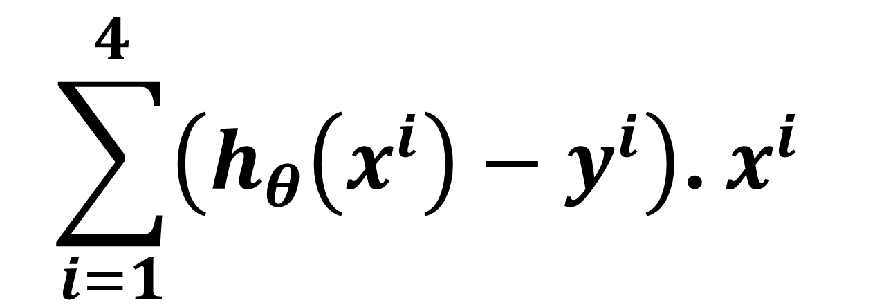
$$\frac{1}{4}\sum_{i=1}^{4}{\left({h_{θ}\left(x^{i}\right)−y}^{i}\right)}$$
$$\frac{1}{4}\sum_{i=1}^{4}{\left({h_{θ}\left(x^{i}\right)−y}^{i}\right)\text{. }x^{i} }$$
$$\frac{∂}{∂θ_{0}}J(θ_{0},θ_{1})=$$
390.25
$$\frac{∂}{∂θ_{1}}J(θ_{0},θ_{1})=$$
$$θ_{0}$$
$$θ_{1}$$
450 | 0.15
$$\sum_{i=1}^{4}{\left({h_{θ}\left(x^{i}\right)−y}^{i}\right)\text{. }x^{i} }$$
$$θ_{0}−α×\frac{∂}{∂θ_{0}}J(θ_{0},θ_{1})$$
$$α×\frac{∂}{∂θ_{0}}J(θ_{0},θ_{1})$$
$$h_{θ}(x^{i})$$
$$y^{i}$$
$$\left({h_{θ}\left(x^{i}\right)−y}^{i}\right)$$
$$\left({h_{θ}\left(x^{i}\right)−y}^{i}\right)\text{. }x^{i}$$
1 | 2104
1 | 1416
1 | 1534
1 | 852
765.6
662.4
680.1
577.8
400
232
315
178
$$×$$
365.6
430.4
365.1
399.8
769,222
609,446
559,910
340,630
$$α×\frac{∂}{∂θ_{1}}J(θ_{0},θ_{1})$$
$$θ_{1}−α×\frac{∂}{∂θ_{1}}J(θ_{0},θ_{1})$$
sum
$$×$$
sum
2,279,208
$$×$$
sum
sum
$$×$$

Slide 66
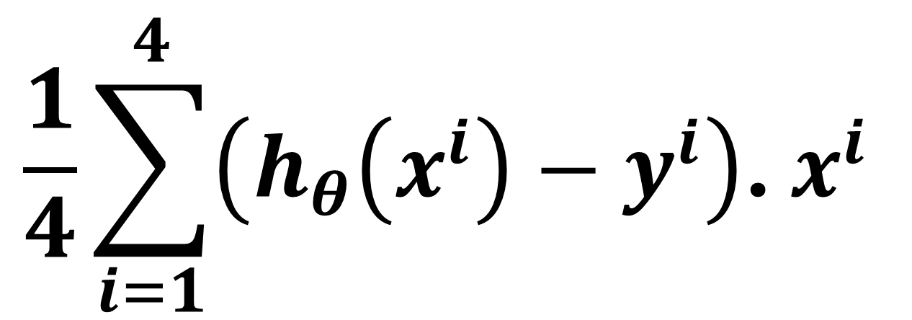
$$\frac{1}{4}\sum_{i=1}^{4}{\left({h_{θ}\left(x^{i}\right)−y}^{i}\right)}$$
$$\frac{1}{4}\sum_{i=1}^{4}{\left({h_{θ}\left(x^{i}\right)−y}^{i}\right)\text{. }x^{i} }$$
$$\frac{∂}{∂θ_{0}}J(θ_{0},θ_{1})=$$
390.25
$$\frac{∂}{∂θ_{1}}J(θ_{0},θ_{1})=$$
$$θ_{0}$$
$$θ_{1}$$
450 | 0.15
$$\sum_{i=1}^{4}{\left({h_{θ}\left(x^{i}\right)−y}^{i}\right)\text{. }x^{i} }$$
$$\frac{1}{4}\sum_{i=1}^{4}{\left({h_{θ}\left(x^{i}\right)−y}^{i}\right)\text{. }x^{i} }$$
$$θ_{0}−α×\frac{∂}{∂θ_{0}}J(θ_{0},θ_{1})$$
$$α×\frac{∂}{∂θ_{0}}J(θ_{0},θ_{1})$$
$$h_{θ}(x^{i})$$
$$y^{i}$$
$$\left({h_{θ}\left(x^{i}\right)−y}^{i}\right)$$
$$\left({h_{θ}\left(x^{i}\right)−y}^{i}\right)\text{. }x^{i}$$
1 | 2104
1 | 1416
1 | 1534
1 | 852
765.6
662.4
680.1
577.8
400
232
315
178
$$×$$
365.6
430.4
365.1
399.8
769,222
609,446
559,910
340,630
$$α×\frac{∂}{∂θ_{1}}J(θ_{0},θ_{1})$$
$$θ_{1}−α×\frac{∂}{∂θ_{1}}J(θ_{0},θ_{1})$$
sum
$$×$$
sum
569,802
2,279,208
divide by m
$$×$$
sum
sum
$$×$$

Slide 67
$$\frac{1}{4}\sum_{i=1}^{4}{\left({h_{θ}\left(x^{i}\right)−y}^{i}\right)}$$
$$\frac{1}{4}\sum_{i=1}^{4}{\left({h_{θ}\left(x^{i}\right)−y}^{i}\right)\text{. }x^{i} }$$
$$\frac{∂}{∂θ_{0}}J(θ_{0},θ_{1})=$$
390.25
$$\frac{∂}{∂θ_{1}}J(θ_{0},θ_{1})=$$
569,802
$$θ_{0}$$
$$θ_{1}$$
450 | 0.15
$$\sum_{i=1}^{4}{\left({h_{θ}\left(x^{i}\right)−y}^{i}\right)\text{. }x^{i} }$$
$$\frac{1}{4}\sum_{i=1}^{4}{\left({h_{θ}\left(x^{i}\right)−y}^{i}\right)\text{. }x^{i} }$$
$$θ_{0}−α×\frac{∂}{∂θ_{0}}J(θ_{0},θ_{1})$$
$$α×\frac{∂}{∂θ_{0}}J(θ_{0},θ_{1})$$
$$h_{θ}(x^{i})$$
$$y^{i}$$
$$\left({h_{θ}\left(x^{i}\right)−y}^{i}\right)$$
$$\left({h_{θ}\left(x^{i}\right)−y}^{i}\right)\text{. }x^{i}$$
1 | 2104
1 | 1416
1 | 1534
1 | 852
765.6
662.4
680.1
577.8
400
232
315
178
$$×$$
365.6
430.4
365.1
399.8
769,222
609,446
559,910
340,630
$$α×\frac{∂}{∂θ_{1}}J(θ_{0},θ_{1})$$
$$θ_{1}−α×\frac{∂}{∂θ_{1}}J(θ_{0},θ_{1})$$
sum
$$×$$
sum
569,802
2,279,208
divide by m
$$×$$
sum
sum
$$×$$

Slide 68
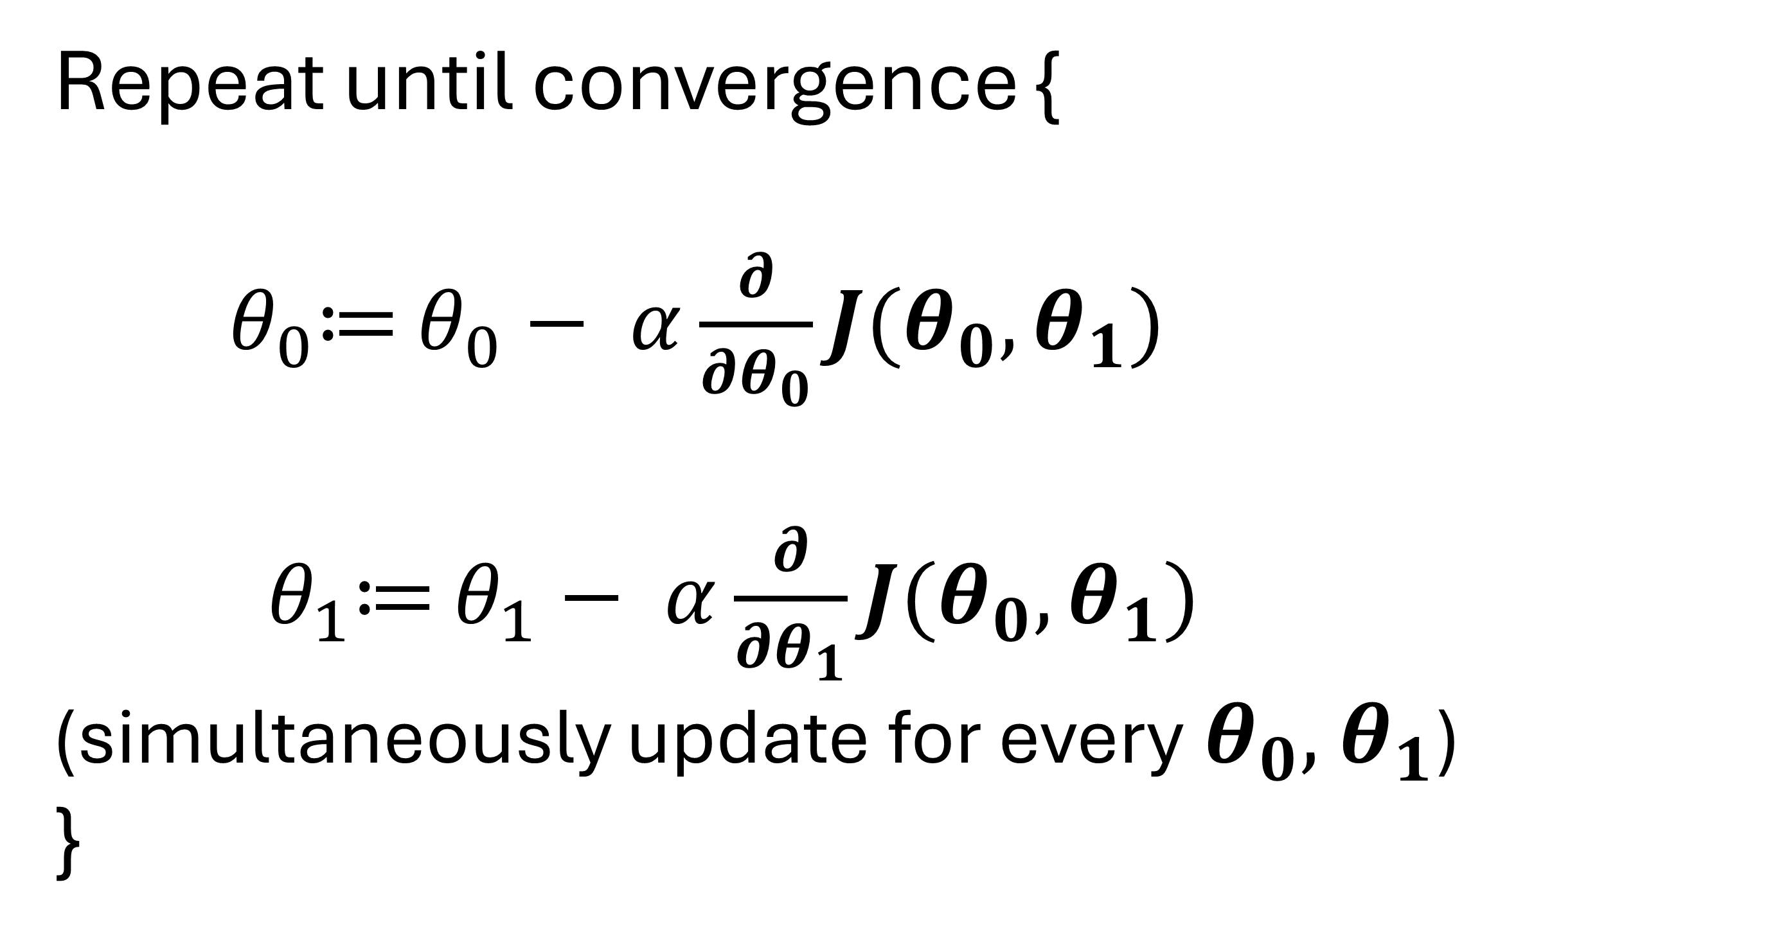
$$\frac{1}{4}\sum_{i=1}^{4}{\left({h_{θ}\left(x^{i}\right)−y}^{i}\right)}$$
$$\frac{1}{4}\sum_{i=1}^{4}{\left({h_{θ}\left(x^{i}\right)−y}^{i}\right)\text{. }x^{i} }$$
569,802
$$\frac{∂}{∂θ_{0}}J(θ_{0},θ_{1})=$$
390.25
$$\frac{∂}{∂θ_{1}}J(θ_{0},θ_{1})=$$
$$θ_{0}$$
$$θ_{1}$$
450 | 0.15
Repeat until convergence {
${ θ}_{0}≔$ $θ_{0}− α\frac{∂}{∂θ_{0}}J(θ_{0},θ_{1})$
${ θ}_{1}≔$ $θ_{1}− α\frac{∂}{∂θ_{1}}J(θ_{0},θ_{1})$
(simultaneously update for every${ θ}_{0},{ θ}_{1}$)
}
$$h_{θ}(x^{i})$$
$$y^{i}$$
$$\left({h_{θ}\left(x^{i}\right)−y}^{i}\right)$$
1 | 2104
1 | 1416
1 | 1534
1 | 852
765.6
662.4
680.1
577.8
400
232
315
178
365.6
430.4
365.1
399.8

Slide 69
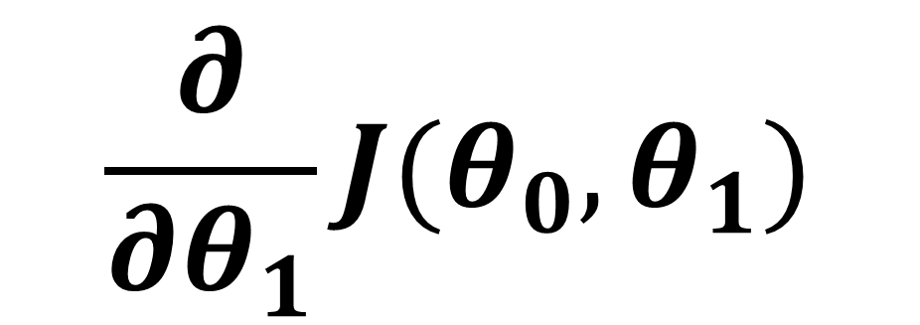
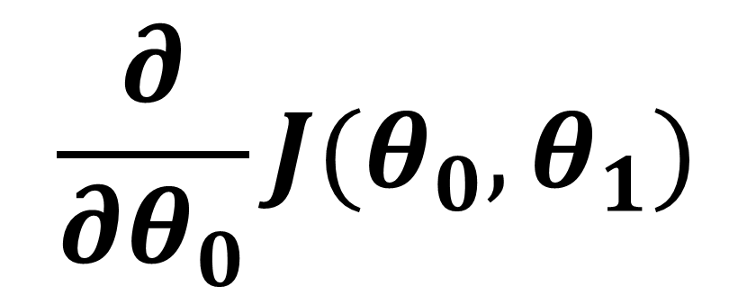
$$\frac{1}{4}\sum_{i=1}^{4}{\left({h_{θ}\left(x^{i}\right)−y}^{i}\right)}$$
$$\frac{1}{4}\sum_{i=1}^{4}{\left({h_{θ}\left(x^{i}\right)−y}^{i}\right)\text{. }x^{i} }$$
569,802
$$\frac{∂}{∂θ_{0}}J(θ_{0},θ_{1})=$$
390.25
$$\frac{∂}{∂θ_{1}}J(θ_{0},θ_{1})=$$
$$θ_{0}$$
$$θ_{1}$$
450 | 0.15
Repeat until convergence {
${ θ}_{0}≔$ $θ_{0}− α\frac{∂}{∂θ_{0}}J(θ_{0},θ_{1})$
${ θ}_{1}≔$ $θ_{1}− α\frac{∂}{∂θ_{1}}J(θ_{0},θ_{1})$
(simultaneously update for every${ θ}_{0},{ θ}_{1}$)
}
$$h_{θ}(x^{i})$$
$$y^{i}$$
$$\left({h_{θ}\left(x^{i}\right)−y}^{i}\right)$$
1 | 2104
1 | 1416
1 | 1534
1 | 852
765.6
662.4
680.1
577.8
400
232
315
178
365.6
430.4
365.1
399.8
$$\frac{∂}{∂θ_{0}}J(θ_{0},θ_{1})$$
390.25
$$\frac{∂}{∂θ_{1}}J(θ_{0},θ_{1})$$
569,802

Slide 70
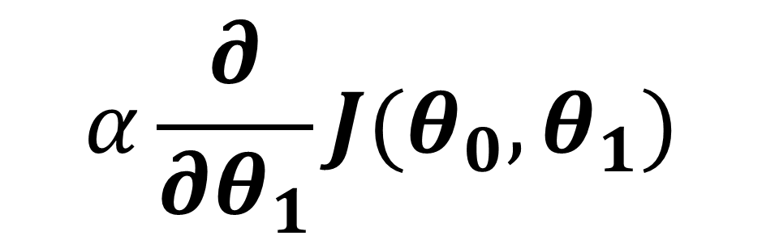
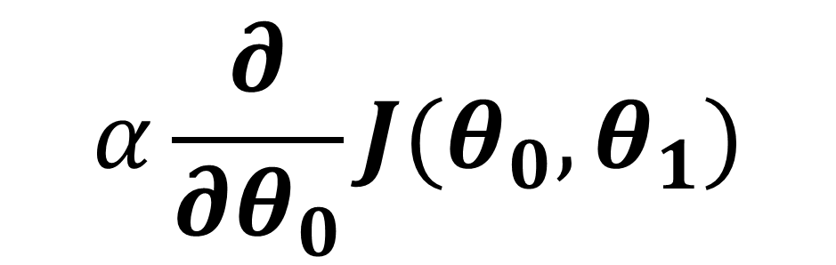
$$\frac{1}{4}\sum_{i=1}^{4}{\left({h_{θ}\left(x^{i}\right)−y}^{i}\right)}$$
$$\frac{1}{4}\sum_{i=1}^{4}{\left({h_{θ}\left(x^{i}\right)−y}^{i}\right)\text{. }x^{i} }$$
569,802
$$\frac{∂}{∂θ_{0}}J(θ_{0},θ_{1})=$$
390.25
$$\frac{∂}{∂θ_{1}}J(θ_{0},θ_{1})=$$
$$θ_{0}$$
$$θ_{1}$$
450 | 0.15
Repeat until convergence {
${ θ}_{0}≔$ $θ_{0}− α\frac{∂}{∂θ_{0}}J(θ_{0},θ_{1})$
${ θ}_{1}≔$ $θ_{1}− α\frac{∂}{∂θ_{1}}J(θ_{0},θ_{1})$
(simultaneously update for every${ θ}_{0},{ θ}_{1}$)
}
$$h_{θ}(x^{i})$$
$$y^{i}$$
$$\left({h_{θ}\left(x^{i}\right)−y}^{i}\right)$$
$$α\frac{∂}{∂θ_{0}}J(θ_{0},θ_{1})$$
1 | 2104
1 | 1416
1 | 1534
1 | 852
765.6
662.4
680.1
577.8
400
232
315
178
365.6
430.4
365.1
399.8
$$\frac{∂}{∂θ_{0}}J(θ_{0},θ_{1})$$
390.25
3.90
$$α\frac{∂}{∂θ_{1}}J(θ_{0},θ_{1})$$
$$\frac{∂}{∂θ_{1}}J(θ_{0},θ_{1})$$
569,802
5,698

Slide 71
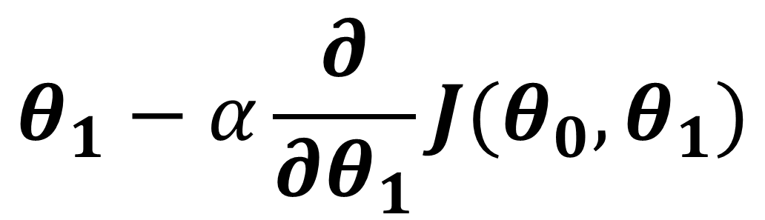

$$\frac{1}{4}\sum_{i=1}^{4}{\left({h_{θ}\left(x^{i}\right)−y}^{i}\right)}$$
$$\frac{1}{4}\sum_{i=1}^{4}{\left({h_{θ}\left(x^{i}\right)−y}^{i}\right)\text{. }x^{i} }$$
569,802
$$\frac{∂}{∂θ_{0}}J(θ_{0},θ_{1})=$$
390.25
$$\frac{∂}{∂θ_{1}}J(θ_{0},θ_{1})=$$
$$θ_{0}$$
$$θ_{1}$$
450 | 0.15
Repeat until convergence {
${ θ}_{0}≔$ $θ_{0}− α\frac{∂}{∂θ_{0}}J(θ_{0},θ_{1})$
${ θ}_{1}≔$ $θ_{1}− α\frac{∂}{∂θ_{1}}J(θ_{0},θ_{1})$
(simultaneously update for every${ θ}_{0},{ θ}_{1}$)
}
$$θ_{0}−α×\frac{∂}{∂θ_{0}}J(θ_{0},θ_{1})$$
$$h_{θ}(x^{i})$$
$$y^{i}$$
$$\left({h_{θ}\left(x^{i}\right)−y}^{i}\right)$$
$$α\frac{∂}{∂θ_{0}}J(θ_{0},θ_{1})$$
$$θ_{0}−α\frac{∂}{∂θ_{0}}J(θ_{0},θ_{1})$$
1 | 2104
1 | 1416
1 | 1534
1 | 852
765.6
662.4
680.1
577.8
400
232
315
178
365.6
430.4
365.1
399.8
$$\frac{∂}{∂θ_{0}}J(θ_{0},θ_{1})$$
390.25
3.90
446.1
$$θ_{1}−α×\frac{∂}{∂θ_{1}}J(θ_{0},θ_{1})$$
$$α\frac{∂}{∂θ_{1}}J(θ_{0},θ_{1})$$
$$θ_{1}−α\frac{∂}{∂θ_{1}}J(θ_{0},θ_{1})$$
$$\frac{∂}{∂θ_{1}}J(θ_{0},θ_{1})$$
569,802
5,698

Slide 72
$$\frac{1}{4}\sum_{i=1}^{4}{\left({h_{θ}\left(x^{i}\right)−y}^{i}\right)}$$
$$\frac{1}{4}\sum_{i=1}^{4}{\left({h_{θ}\left(x^{i}\right)−y}^{i}\right)\text{. }x^{i} }$$
569,802
$$\frac{∂}{∂θ_{0}}J(θ_{0},θ_{1})=$$
390.25
$$\frac{∂}{∂θ_{1}}J(θ_{0},θ_{1})=$$
$$θ_{0}$$
$$θ_{1}$$
450 | 0.15
Repeat until convergence {
${ θ}_{0}≔$ $θ_{0}− α\frac{∂}{∂θ_{0}}J(θ_{0},θ_{1})$
${ θ}_{1}≔$ $θ_{1}− α\frac{∂}{∂θ_{1}}J(θ_{0},θ_{1})$
(simultaneously update for every${ θ}_{0},{ θ}_{1}$)
}
$$θ_{0}−α×\frac{∂}{∂θ_{0}}J(θ_{0},θ_{1})$$
$$h_{θ}(x^{i})$$
$$y^{i}$$
$$\left({h_{θ}\left(x^{i}\right)−y}^{i}\right)$$
$$α\frac{∂}{∂θ_{0}}J(θ_{0},θ_{1})$$
$$θ_{0}−α\frac{∂}{∂θ_{0}}J(θ_{0},θ_{1})$$
1 | 2104
1 | 1416
1 | 1534
1 | 852
765.6
662.4
680.1
577.8
400
232
315
178
365.6
430.4
365.1
399.8
$$\frac{∂}{∂θ_{0}}J(θ_{0},θ_{1})$$
390.25
3.90
446.1
$$θ_{1}−α×\frac{∂}{∂θ_{1}}J(θ_{0},θ_{1})$$
$$α\frac{∂}{∂θ_{1}}J(θ_{0},θ_{1})$$
$$θ_{1}−α\frac{∂}{∂θ_{1}}J(θ_{0},θ_{1})$$
$$\frac{∂}{∂θ_{1}}J(θ_{0},θ_{1})$$
569,802
5,698
-5,697

Slide 73
$$\frac{1}{4}\sum_{i=1}^{4}{\left({h_{θ}\left(x^{i}\right)−y}^{i}\right)}$$
$$\frac{1}{4}\sum_{i=1}^{4}{\left({h_{θ}\left(x^{i}\right)−y}^{i}\right)\text{. }x^{i} }$$
569,802
$$\frac{∂}{∂θ_{0}}J(θ_{0},θ_{1})=$$
390.25
$$\frac{∂}{∂θ_{1}}J(θ_{0},θ_{1})=$$
$$θ_{0}$$
$$θ_{1}$$
446.1 | 0.15
Repeat until convergence {
${ θ}_{0}≔$ $θ_{0}− α\frac{∂}{∂θ_{0}}J(θ_{0},θ_{1})$
${ θ}_{1}≔$ $θ_{1}− α\frac{∂}{∂θ_{1}}J(θ_{0},θ_{1})$
(simultaneously update for every${ θ}_{0},{ θ}_{1}$)
}
$$θ_{0}−α×\frac{∂}{∂θ_{0}}J(θ_{0},θ_{1})$$
$$h_{θ}(x^{i})$$
$$y^{i}$$
$$\left({h_{θ}\left(x^{i}\right)−y}^{i}\right)$$
$$α\frac{∂}{∂θ_{0}}J(θ_{0},θ_{1})$$
$$θ_{0}−α\frac{∂}{∂θ_{0}}J(θ_{0},θ_{1})$$
1 | 2104
1 | 1416
1 | 1534
1 | 852
765.6
662.4
680.1
577.8
400
232
315
178
365.6
430.4
365.1
399.8
$$\frac{∂}{∂θ_{0}}J(θ_{0},θ_{1})$$
390.25
3.90
446.1
$$θ_{1}−α×\frac{∂}{∂θ_{1}}J(θ_{0},θ_{1})$$
$$α\frac{∂}{∂θ_{1}}J(θ_{0},θ_{1})$$
$$θ_{1}−α\frac{∂}{∂θ_{1}}J(θ_{0},θ_{1})$$
$$\frac{∂}{∂θ_{1}}J(θ_{0},θ_{1})$$
569,802
5,698
-5,697

Slide 74
$$\frac{1}{4}\sum_{i=1}^{4}{\left({h_{θ}\left(x^{i}\right)−y}^{i}\right)}$$
$$\frac{1}{4}\sum_{i=1}^{4}{\left({h_{θ}\left(x^{i}\right)−y}^{i}\right)\text{. }x^{i} }$$
569,802
$$\frac{∂}{∂θ_{0}}J(θ_{0},θ_{1})=$$
390.25
$$\frac{∂}{∂θ_{1}}J(θ_{0},θ_{1})=$$
$$θ_{0}$$
$$θ_{1}$$
446.1 | -5697
Repeat until convergence {
${ θ}_{0}≔$ $θ_{0}− α\frac{∂}{∂θ_{0}}J(θ_{0},θ_{1})$
${ θ}_{1}≔$ $θ_{1}− α\frac{∂}{∂θ_{1}}J(θ_{0},θ_{1})$
(simultaneously update for every${ θ}_{0},{ θ}_{1}$)
}
$$θ_{0}−α×\frac{∂}{∂θ_{0}}J(θ_{0},θ_{1})$$
$$h_{θ}(x^{i})$$
$$y^{i}$$
$$\left({h_{θ}\left(x^{i}\right)−y}^{i}\right)$$
$$α\frac{∂}{∂θ_{0}}J(θ_{0},θ_{1})$$
$$θ_{0}−α\frac{∂}{∂θ_{0}}J(θ_{0},θ_{1})$$
1 | 2104
1 | 1416
1 | 1534
1 | 852
765.6
662.4
680.1
577.8
400
232
315
178
365.6
430.4
365.1
399.8
$$\frac{∂}{∂θ_{0}}J(θ_{0},θ_{1})$$
390.25
3.90
446.1
$$θ_{1}−α×\frac{∂}{∂θ_{1}}J(θ_{0},θ_{1})$$
$$α\frac{∂}{∂θ_{1}}J(θ_{0},θ_{1})$$
$$θ_{1}−α\frac{∂}{∂θ_{1}}J(θ_{0},θ_{1})$$
$$\frac{∂}{∂θ_{1}}J(θ_{0},θ_{1})$$
569,802
5,698
-5,697

Slide 75


$$θ_{0}$$
$$θ_{1}$$
$$\frac{∂}{∂θ_{0}}J(θ_{0},θ_{1})$$
$$\frac{∂}{∂θ_{1}}J(θ_{0},θ_{1})$$
450 | 0.15
$$\frac{1}{m}\sum_{i=1}^{m}{\left({h_{θ}\left(x^{i}\right)−y}^{i}\right)}$$
$$\frac{1}{m}\sum_{i=1}^{m}{\left({h_{θ}\left(x^{i}\right)−y}^{i}\right)\text{. }x^{i} }$$
$$α×\frac{∂}{∂θ_{0}}J(θ_{0},θ_{1})$$
$$θ_{0}−α×\frac{∂}{∂θ_{0}}J(θ_{0},θ_{1})$$
$$h_{θ}(x^{i})$$
$$y^{i}$$
$$\left({h_{θ}\left(x^{i}\right)−y}^{i}\right)$$
1 | 2104
1 | 1416
1 | 1534
1 | 852
400
232
315
178
$$α×\frac{∂}{∂θ_{1}}J(θ_{0},θ_{1})$$
$$θ_{1}−α×\frac{∂}{∂θ_{1}}J(θ_{0},θ_{1})$$

